Slide 1
Supporting the frontline through challenging times – the power of the in-house lawyer to make a difference
Greg Brogden, Principal Legal Counsel, Te Waipounamu
Iris Reuvecamp, Legal Counsel, Mental Health, Addiction and Intellectual Disability Service – Capital, Coast, Hutt Valley and Wairarapa Districts

Slide 2
Overview
The value we add as inhouse lawyers
The support we provide to the organization and staff
Our ability to influence and effect change

Slide 3

Our perspective
  Health New Zealand | Te Whatu Ora Specialist Clinico-Legal Inhouse Lawyers

Slide 4
The value we add as inhouse lawyers
  The relationships of trust we build with managers and others in our organisation
  Our ability to connect (and escalate to) people within the organisation who need to be involved
  Building connections with key stakeholders and regulators outside the organisation
  Our knowledge and understanding of the subject matter (both legal and practical)
  Our knowledge of how the organisation works, and the key risks
  We are often the ‘conscience’ of the organisation

Slide 5

We bring a perspective…
As part of a multi-disciplinary team
….that contributes to discussion and consideration of the way forward
Our perspective is only one perspective of many
We contribute to a robust decision-making process by the decision-maker (not us)

Slide 6
The support we provide to Health NZ
In a day-to-day sense in relation to legal, commercial and sometimes ethical situations which arise
In relation to issues with significant implications and/or which become urgent
When these matters go to Court

Slide 7
In a day to day sense
Commercial negotiations, contract preparation or review and disputes
Providing advice on a wide range of matters at different levels of the organisation
Engaging with external regulatory agencies

Slide 8
Some examples:
Significant implications or urgent situations
A person who has been in a car accident with a suspected traumatic brain injury wants to leave ED – can you stop them?
A person keeps presenting to ED after swallowing harmful objects, necessitating surgery, but they refuse to consent to surgery – can you proceed?
A person in labour, who defers to their partner in all decision-making, and the partner is strongly opposed to a caesarean section even though the baby is in distress – what do you do?
The police turn up and ask you to hand over a person’s clinical records for the purposes of their investigation – what do you do?

Slide 9
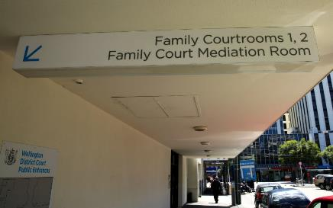
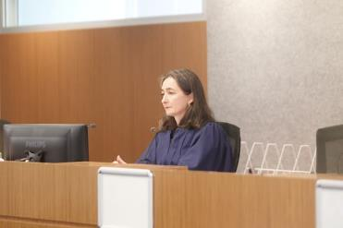
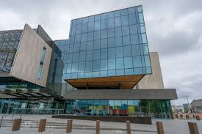
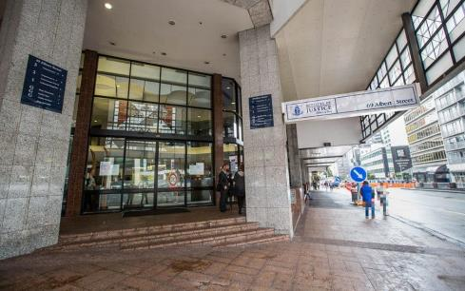
When we go to Court

Slide 10
A range of situations
Family Court:
  Adults - applications for personal orders (including treatment orders and placement orders)
  Children – applications to the Court regarding treatment decisions, custody proceedings, child and protection concerns
District Court – requests for disclosure of complainant/victims mental health information in the context of a criminal proceeding
Coroners Court - inquests
High Court – withdrawal of treatment/declaratory judgments

Slide 11

Family Court

Slide 12
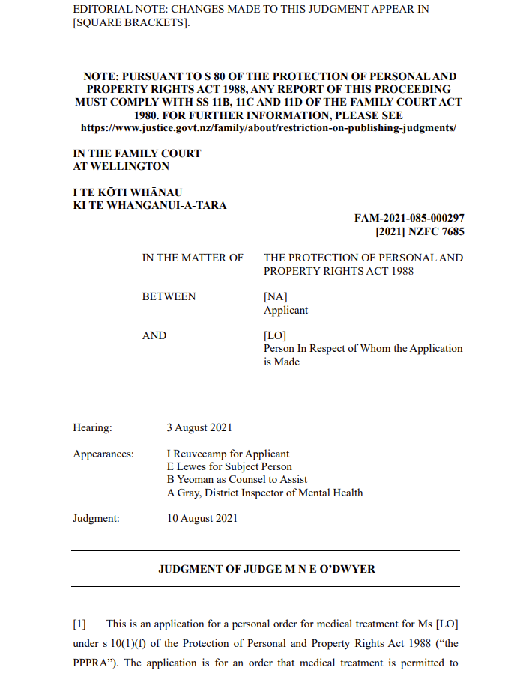
An example
A person had arranged to have
a termination of pregnancy
They had travelled for the termination
but had then become acutely mentally
unwell
They were unlikely to regain
decision-making capacity within the relevant
timeframe, which meant they would
need to undergo a more significant
procedure further on in their pregnancy,
which they were unlikely to tolerate
If no intervention, the pregnancy would
proceed, potentially contrary to
the person’s wishes
But – legal basis for proceeding in
circumstances where the person changed their
mind on a day to day basis was unclear

Slide 13
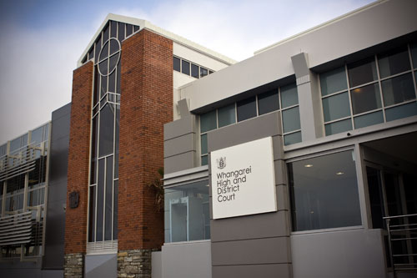
District Court

Slide 14
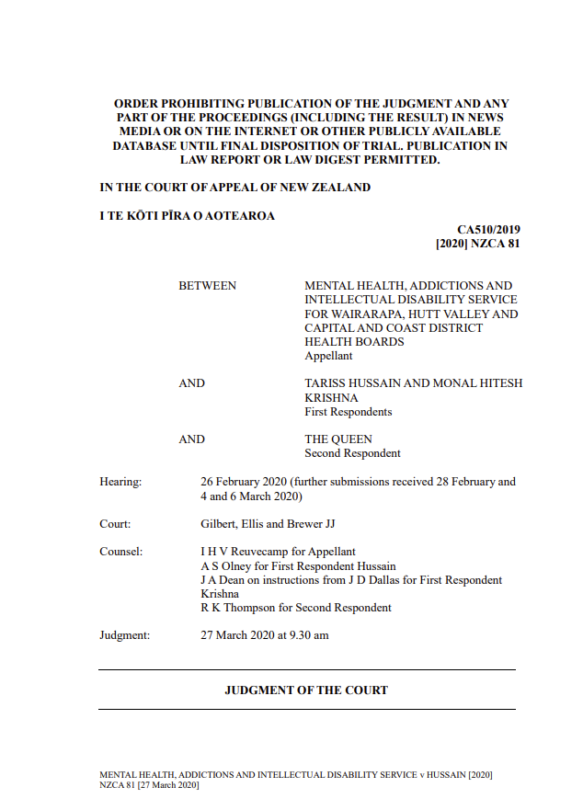
Criminal Disclosure Act 2008
In certain circumstances, a defendant
can request information from a non-party
if it will help their defence
Sometimes, an application for a
non-party disclosure order is made
for medical/mental health records
held by Health New Zealand
Our job is to safeguard the privacy
interests of our patients
….sometimes all the way up on appeal

Slide 15

Coroners Court

Slide 16
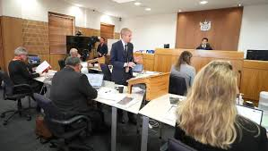
Coroners Court
Contributing to an inquiry
When a matter goes to inquest

Slide 17
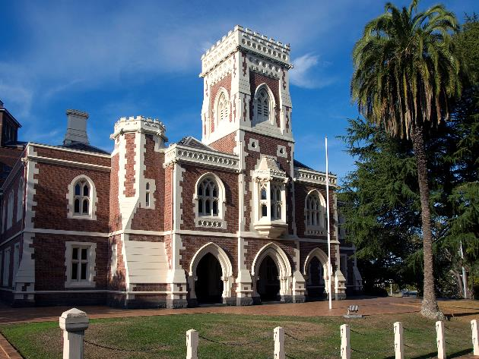
High Court

Slide 18

Some interesting case studies

Slide 19
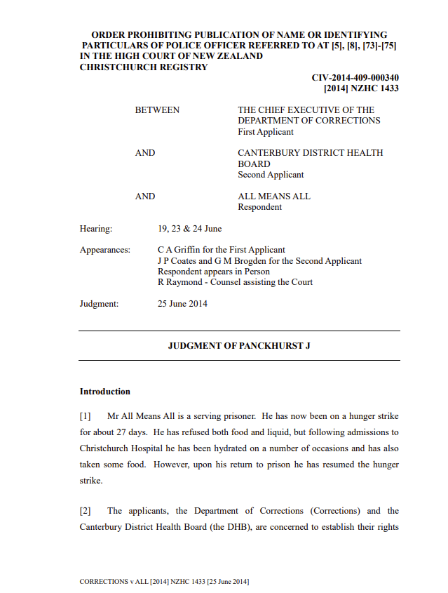
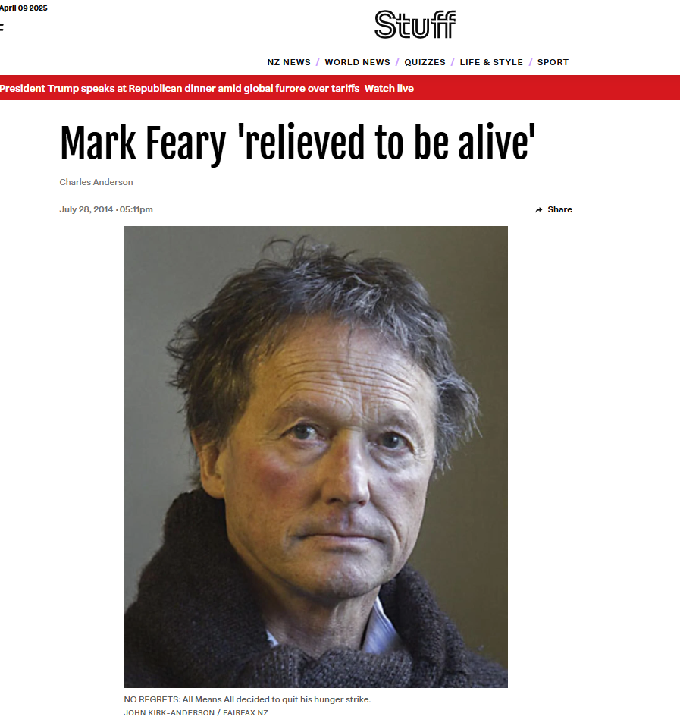
Chief Executive of the Department of Corrections v All Means All [2014] NZHC 1433

Slide 20
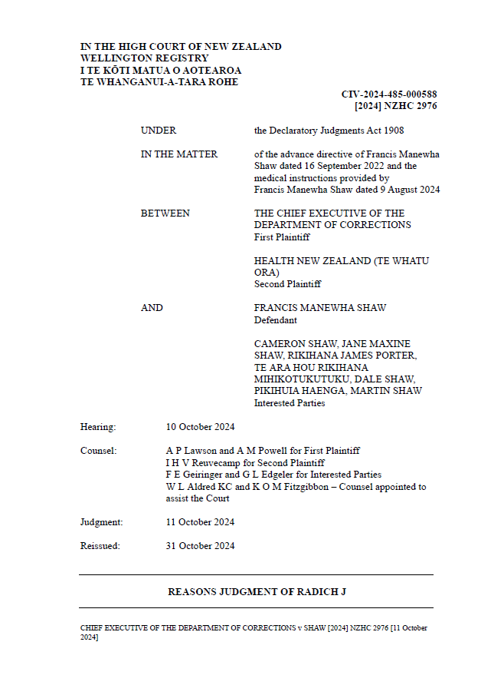
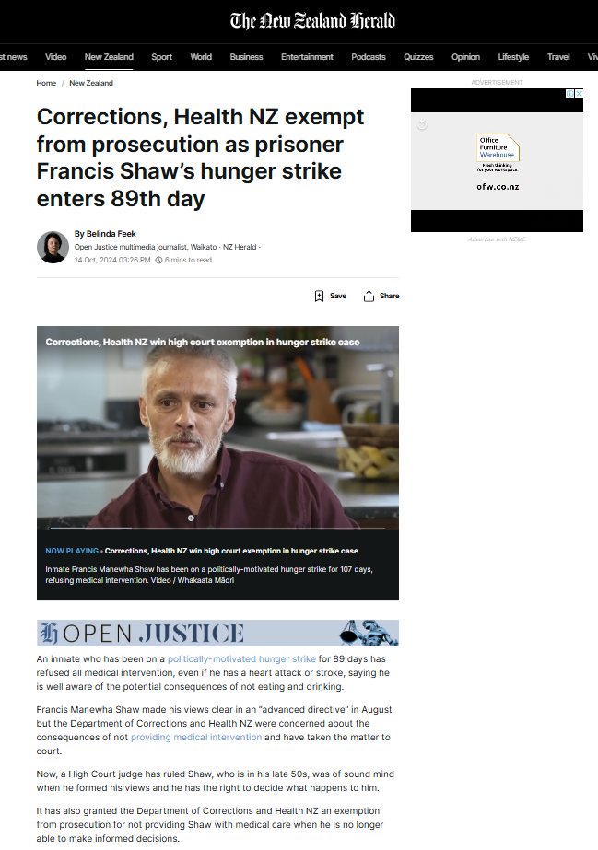
Chief Executive of the Department of Corrections v Shaw [2024] NZHC 2976

Slide 21
Key issues
Both hunger striking prisoners with advance directives refusing artificial nutrition and hydration
All Means All – the question was whether he had decision-making capacity to make the advance directive in question
Shaw - the question was initially whether he had decision-making capacity and later, the form of the advance directive

Slide 22
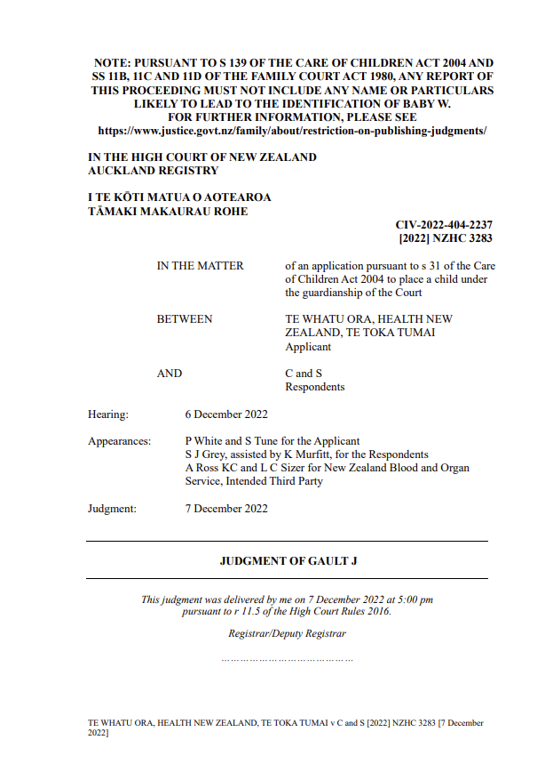
Te Whatu Ora, Health New Zealand Te Toka Tumai v C and S [2022] NZHC 3283

Slide 23
Background
Baby W needed an urgent heart operation.
Parents accepted the need for surgery but refused to consent to the blood transfusion because of concerns that the blood would contain COVID-19 mRNA vaccine with spike proteins that would not be safe for Baby W.
They sought the use of blood from directed donors (i.e. selected donors who are not vaccinated with the mRNA vaccine)
Options explored included: undertaking the surgery without the use of blood products, and whether it was possible to use the blood from directed donors
Health NZ sought to have the medical specialists appointed as agents of the Court for the purpose of consenting to surgery and related medical issues, and the parents otherwise appointed as general agents of the Court.
Timeframes – proceedings commenced on 28 November 2022; first call on 30 November 2022; affidavit evidence filed; hearing on 6 December 2022.

Slide 24
Key issues
Overriding issue - whether the proposed treatment was in Baby W’s best interests
Factual issues:
  whether the clinicians’ proposed use of NZBS blood products was safe;
  whether the parents’ proposed use of directed blood was a safe and viable alternative
Held: NZBS practice in relation to directed donors was in accordance with standard medical practice in the UK, Australia and Canada, and the EDQM guidance. The parents’ alternative proposal was not an available alternative offered by NZBS. It was not supported by a clinician’s opinion knowing Baby W’s state, nor by peer reviewed articles. It was not a safe alternative that was in Baby W’s best interests.
Primary orders sought were made

Slide 25
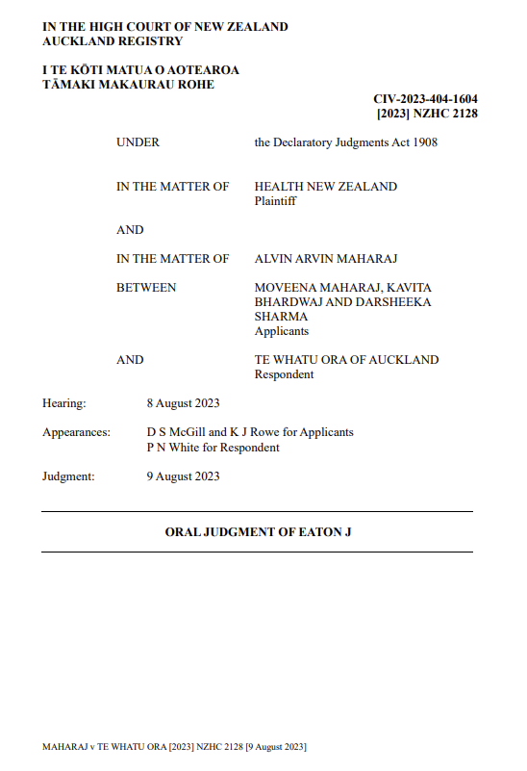
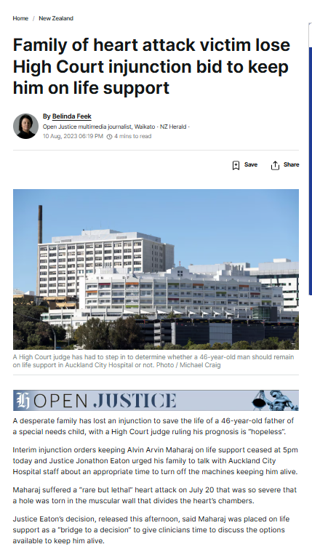
Maharaji v Te Whatu Ora [2023] NZHC 2128

Slide 26
Chronology
20 July 2023 - Mr Maharaj suffered a heart attack and was placed on life support
3 August 2023 - Mr Maharaj’s family was advised of a decision to remove Mr Maharaj from life support the following day, there being no surgical or interventional options available to save Mr Maharaj’s life; and other patients with survivable conditions would have to be turned away in order to keep Mr Maharaj alive.
4 August 2023 - the family wrote to Health NZ confirming the family did not consent to the removal of life support and asking for at least five days to allow the family to obtain independent medical advice.
Late on 4 August 2023 - two applications were filed. Health NZ filed a statement of claim under the Declaratory Judgments Act 1908, seeking an order that it was lawful for Mr Maharaj’s treating clinicians to turn off life support with the effect that it would cause his death (and any ancillary orders appropriate or necessary)
Mr Maharaj’s sisters filed a notice of an interlocutory application for an interim injunction seeking orders that Health NZ refrain from turning off life support and continue to provide medical care as required until an independent medical opinion had been obtained and the family had carried out religious duties.
Evening of 4 August 2023 – two judicial teleconferences
7 August 2023 – evidence filed, further judicial teleconference
8 August 2023 - hearing

Slide 27
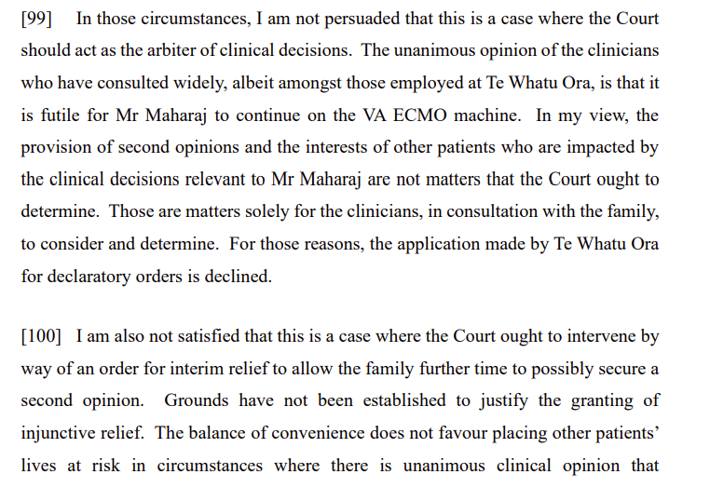
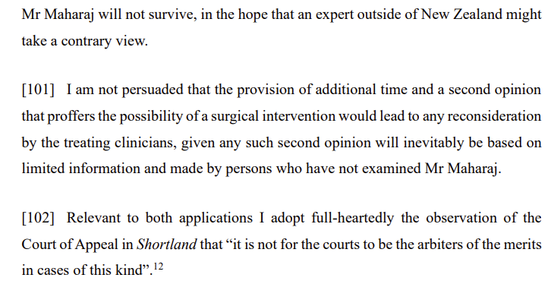
Decision

Slide 28
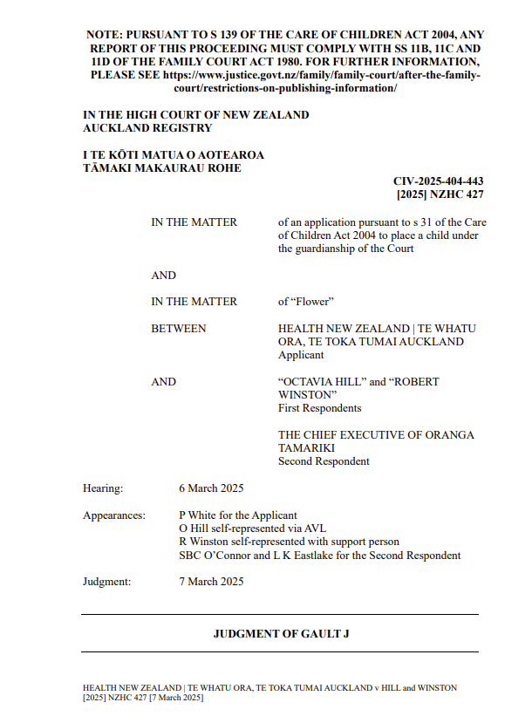
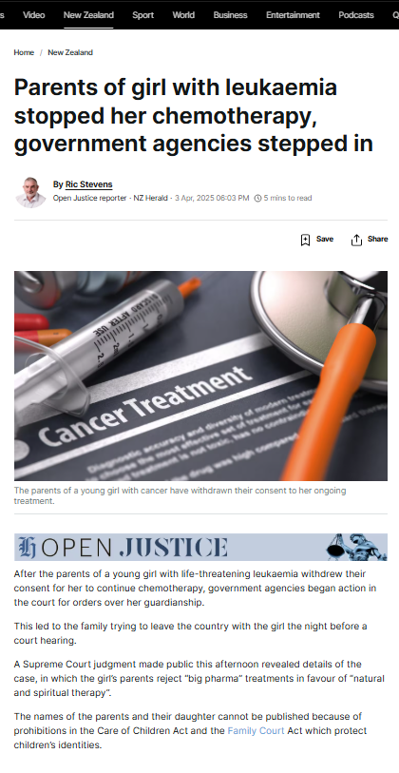
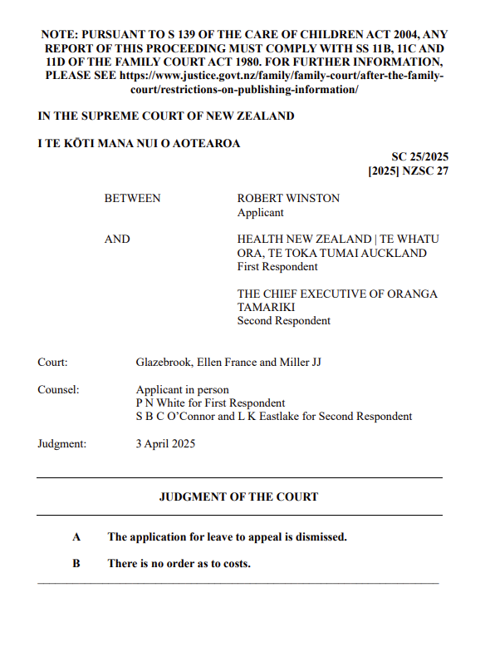
Health New Zealand | Te Whatu Ora, Te Toka Tumai Auckland v Hill [2025] NZHC 427
and
Winston v Health New Zealand [2025] NZSC 27

Slide 29
Chronology
Flower was a six-year-old girl who has been diagnosed with B-cell acute lymphoblastic leukaemia, a type of cancer that develops in the bone marrow.
Flower completed induction chemotherapy treatment, but after beginning consolidation treatment on 13 January 2025, Flower’s parents withdrew consent to her ongoing treatment.
17 February 2025 – ROC to Oranga Tamariki
21 February 2025 – Parents and clinicians met
24 February 2025 – treatment due to be re-commenced, but id not attend
27 February 2025 – proceedings filed by Health NZ
5 March 2025 – Health NZ filed an application for an urgent interim guardianship order because the family were alleged to be trying to leave the country. Granted by the Court.
6 March 2025 - hearing

Slide 30
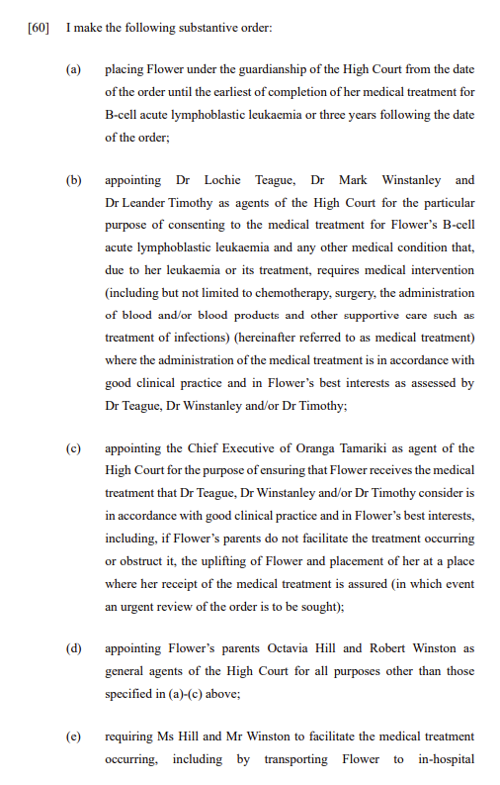
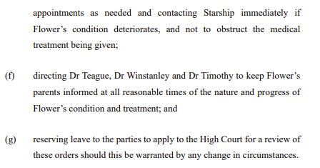
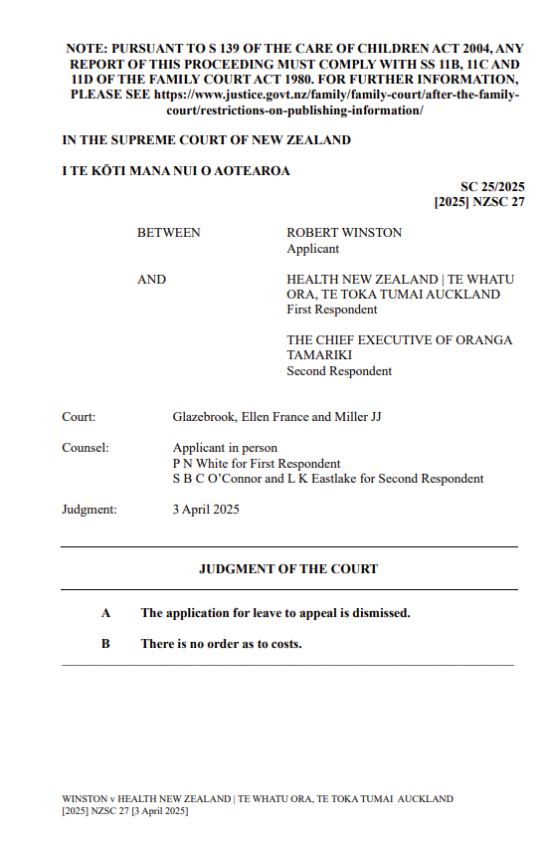
Decision(s)

Slide 31
Common themes
Life and death situations
Involving many different parties with a range of interests
Often emotional and distressing for all involved
Requires near immediate and decisive decision-making
And considered, confident advice and guidance
Time is usually not on your side
Evidence and the presentation of evidence and submissions often needs to happen fast – within a few hours or days
Your role is to guide, support, advise, navigate, prepare, escalate
And – the media is often also involved, so that needs to be managed too

Slide 32
Our role
Recognising the risks for the organization and staff
Drawing on our subject matter expertise to map out the way forward
Seeking the authority of the Court to enable determination of the patient’s rights, whilst also protecting the organization and staff
Providing urgent advice and guidance on steps to be taken to provide the Court with the best information possible to make a determination
Drawing on our relationships, and the trust and confidence of our clinical and managerial colleagues, to support them, escalate appropriately, and prepare the case for hearing
Appearing at short notice, and ensuring the issues for determination before the Court are focused and constrained (given the urgency)

Slide 33
What difference do we make in these proceedings?
We are able to act quickly
We are able to identify, articulate and advise on the legal and practical issues on the basis of our experience and expertise
We are able to support our managers and clinicians through a process that is often urgent and has significant consequences
We provide access to a mechanism that allows our clinicians and managers to do the right thing
This is our playground – it is not a fun place for non-lawyers, and it is our job to help them navigate this, whether we are acting ourselves or instructing external lawyers

Slide 34

We have influence and are able to effect change
Through:
  Our understanding of the organisation
  Our knowledge and expertise of the law and the operating environment
  Our relationships and connections
  Building trust and confidence
  Operating within the values and culture of the organisation
  Escalating issues where appropriate
  Monitoring actions intended to effect change

Slide 35
Take home messages
Be passionate about what you and your team do. You do make a real difference!
Use every opportunity to learn more about the business of your organisation – the more you know the better you can advise.
Build those connections, both within and outside the organisation
Look after yourself and others in the team. It can be a tough gig – and, depending on the nature of your work, may impact on your own wellbeing
Make sure you acknowledge the potential for that impact, and that you seek support

Slide 36
Questions?

