Slide 1
Slido Question 1: Have you ever been a part of a large insurance claim in a business:
A: Yes
No: No
Slido Question 2: Is your legal team in your business responsible for obtaining insurance policies and annual renewals?
A: Yes
No: No

Slide 2
Slido question: What does the number 832 represent?
A: How many flights were disrupted during the flood
B: How many meetings there have been on the flood
C: How many days since the Auckland flood

Slide 3
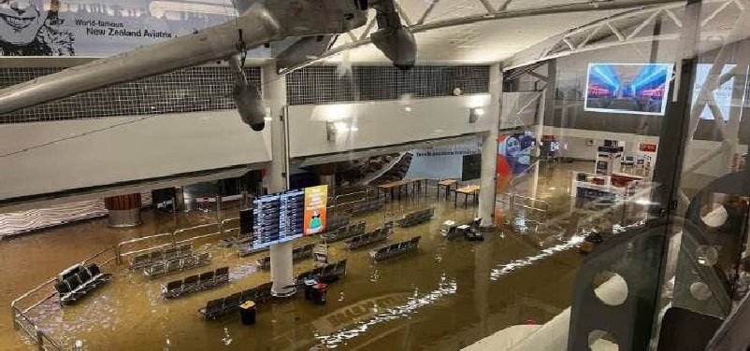
Auckland Airport Flood Crisis Response and Recovery Plan
Strategies for managing crisis, insurance claims and recovery efforts
Louise Martin
Head of legal & Co Sec
Notes:
Welcome. My name is Louise Martin, Head of Legal and Co Sec at Auckland Airport. I have come here today to discuss my experiences with a crisis event and the insurance claim that followed. I want to acknowledge, that some of you in the room may have been personally impacted by this flood event, or your business may have been impacted. I hope that you have come through the event and no doubt some of what I will discuss today will ring true with you. ---

Slide 4
Agenda All with an insurance claim lens
Overview of the Flood Incident
Immediate Actions Taken
Short-Term Recovery Efforts
Medium-Term Strategies for Business Continuity
Legal Role in Insurance Claims
Notes:
I will begin by discussing the flood incident. Following this, I have divided the session into time periods. The immediate, the short term and the long term after the event. At the conclusion of each time period I have set out my key learnings.
I will also explore the legal aspects of insurance claims.
Slides will be shared so no need to take notes.

Slide 5

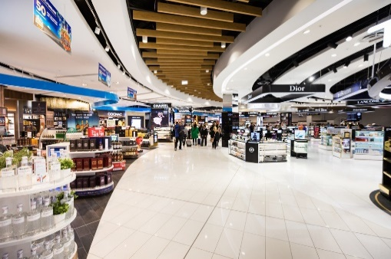

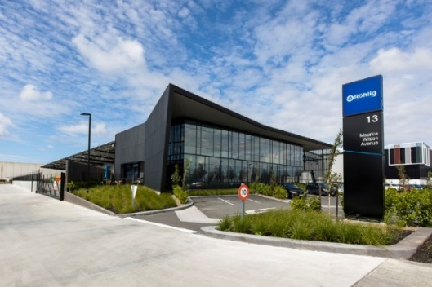
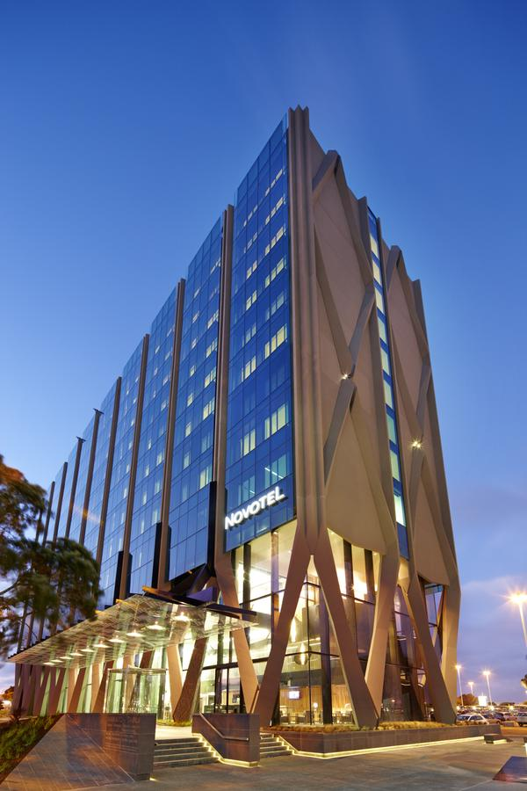
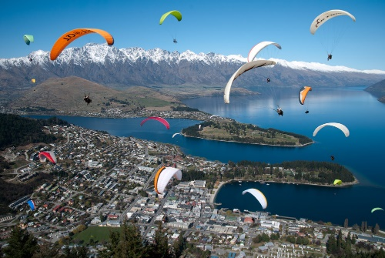
Overview of Auckland Airport
Diverse and complementary business activities
Aeronautical | Retail | Transport
Investment Property | Hotels | Queenstown Airport
Notes:
While many of you will have been to Auckland Airport, some just yesterday or today, I often find that people do not have a full understanding of our business. To help you understand how the flood impacted our business, I wanted to pause and explain the breadth of our company.

Slide 6
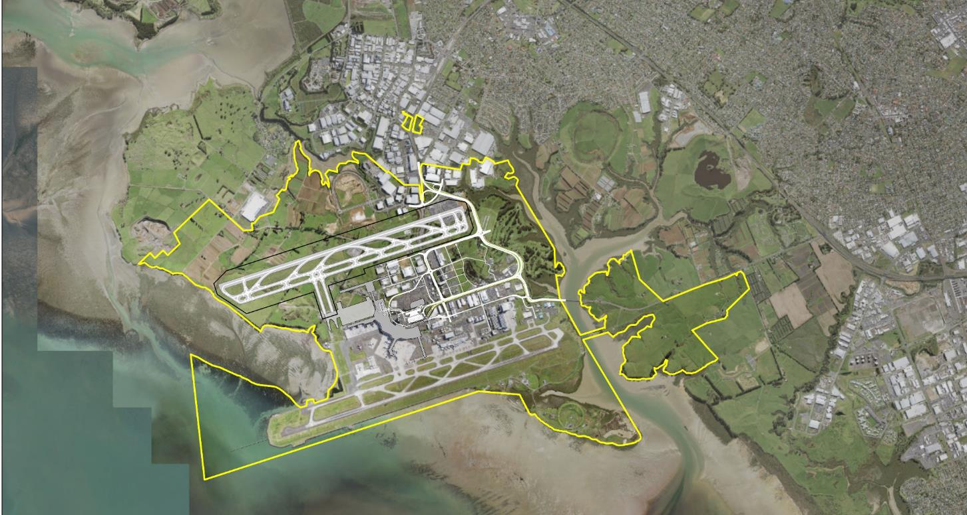
1500 ha land holding enables a precinct wide vision
Notes:
1. Pre-COVID-19, for the 12 months to 31 Dec 2019

Slide 7
Overview of the Flood Incident

Slide 8
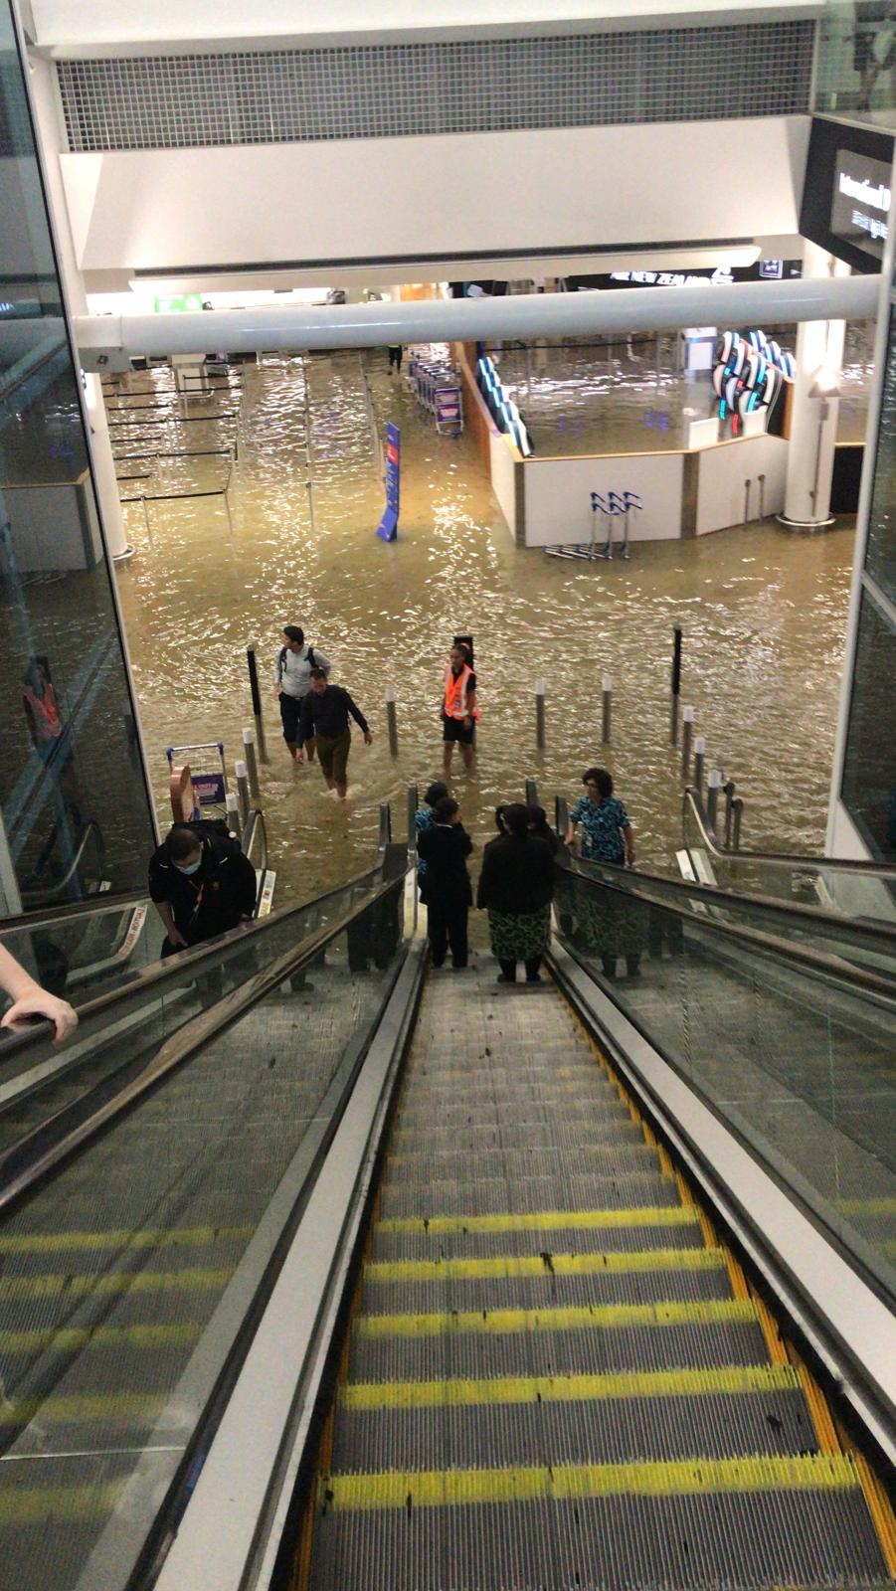
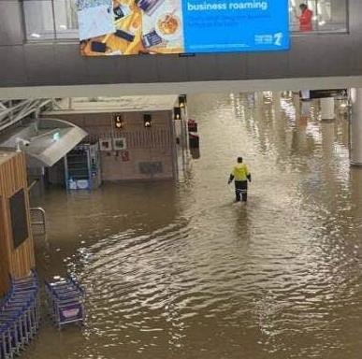
Record-Breaking Rainfall
Record Rainfall Event
On January 27, 2023, Auckland experienced unprecedented rainfall, shattering previous records and leading to widespread flooding.
The rapid flooding severely impacted infrastructure, homes, and livelihoods throughout Auckland.
Auckland Airport received more than its average monthly rainfall for January (258mm) within one day.​ This was after heavy rain in the week before.
The most significant areas of damage were at the international terminal building. At its peak water was 300mm deep.
Notes:
On January 27, 2023, Auckland experienced record-breaking rainfall that led to severe flash flooding at the airport.
This unprecedented weather event necessitated immediate attention and response measures to mitigate its impacts.

Slide 9
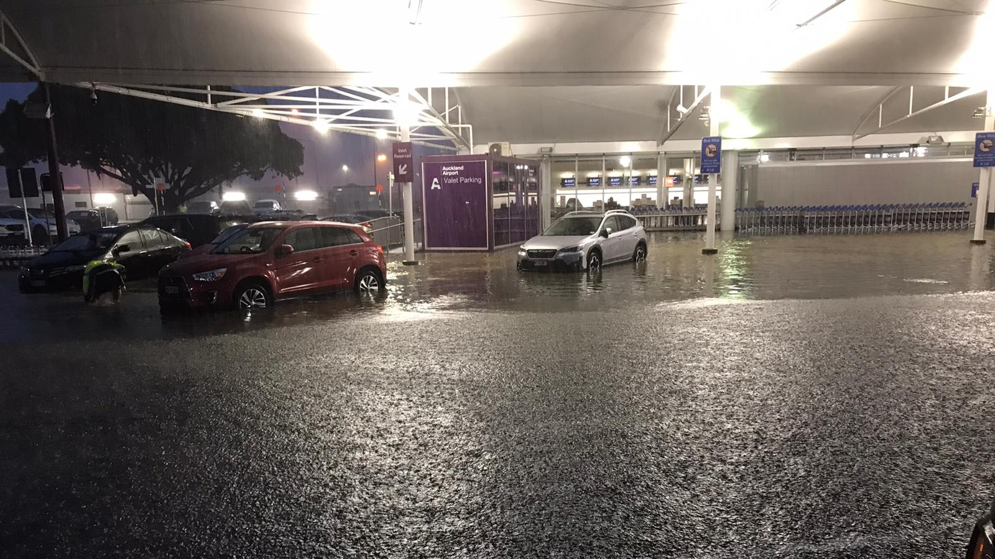

Slide 10
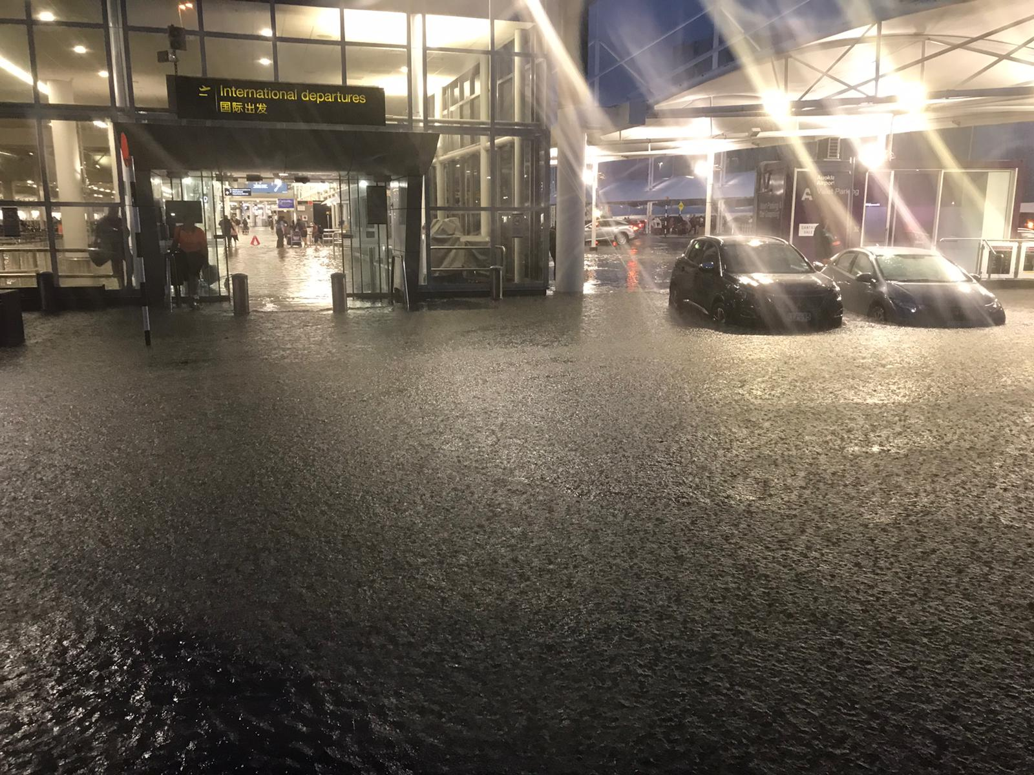

Slide 11
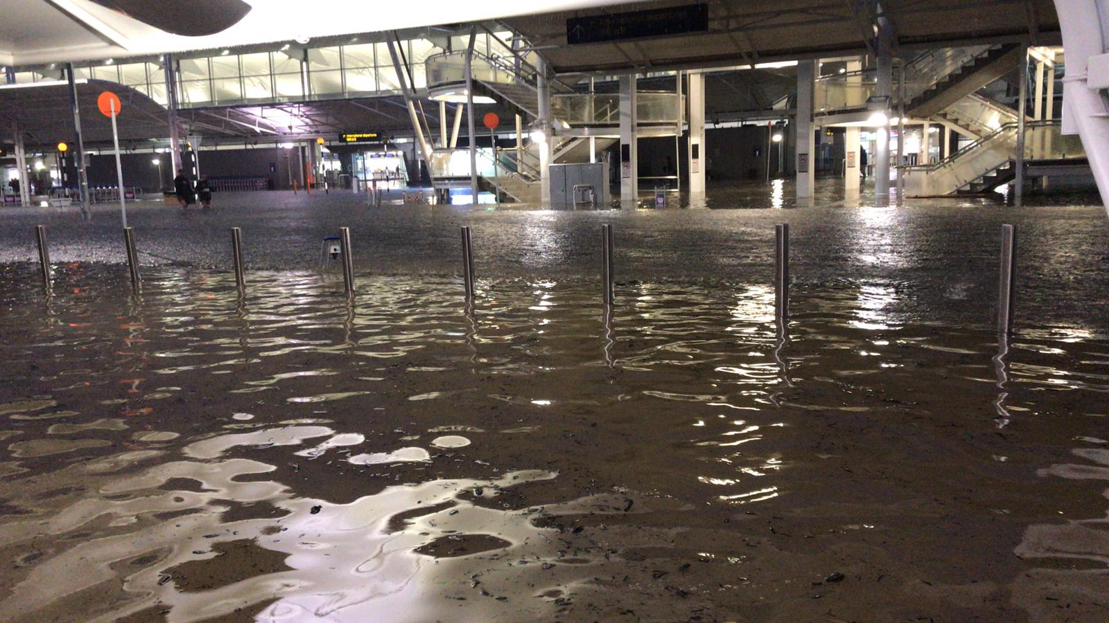

Slide 12
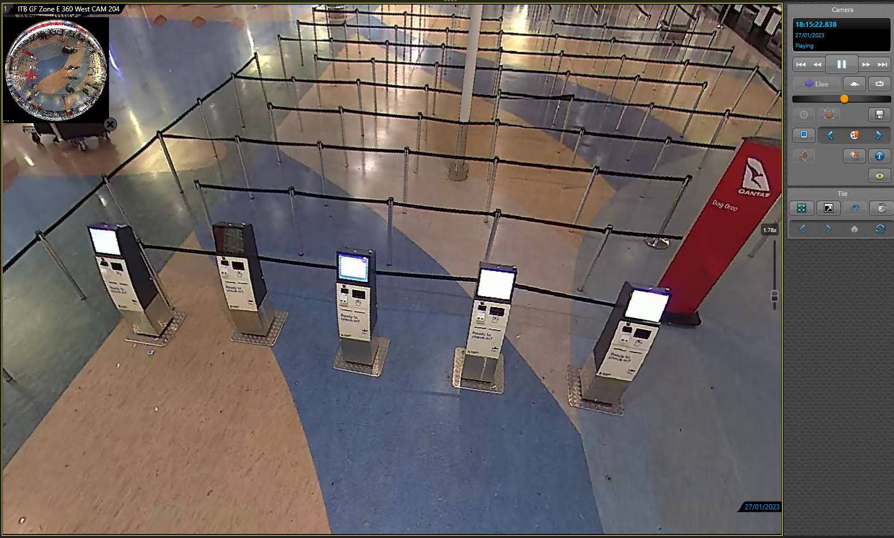

Slide 13
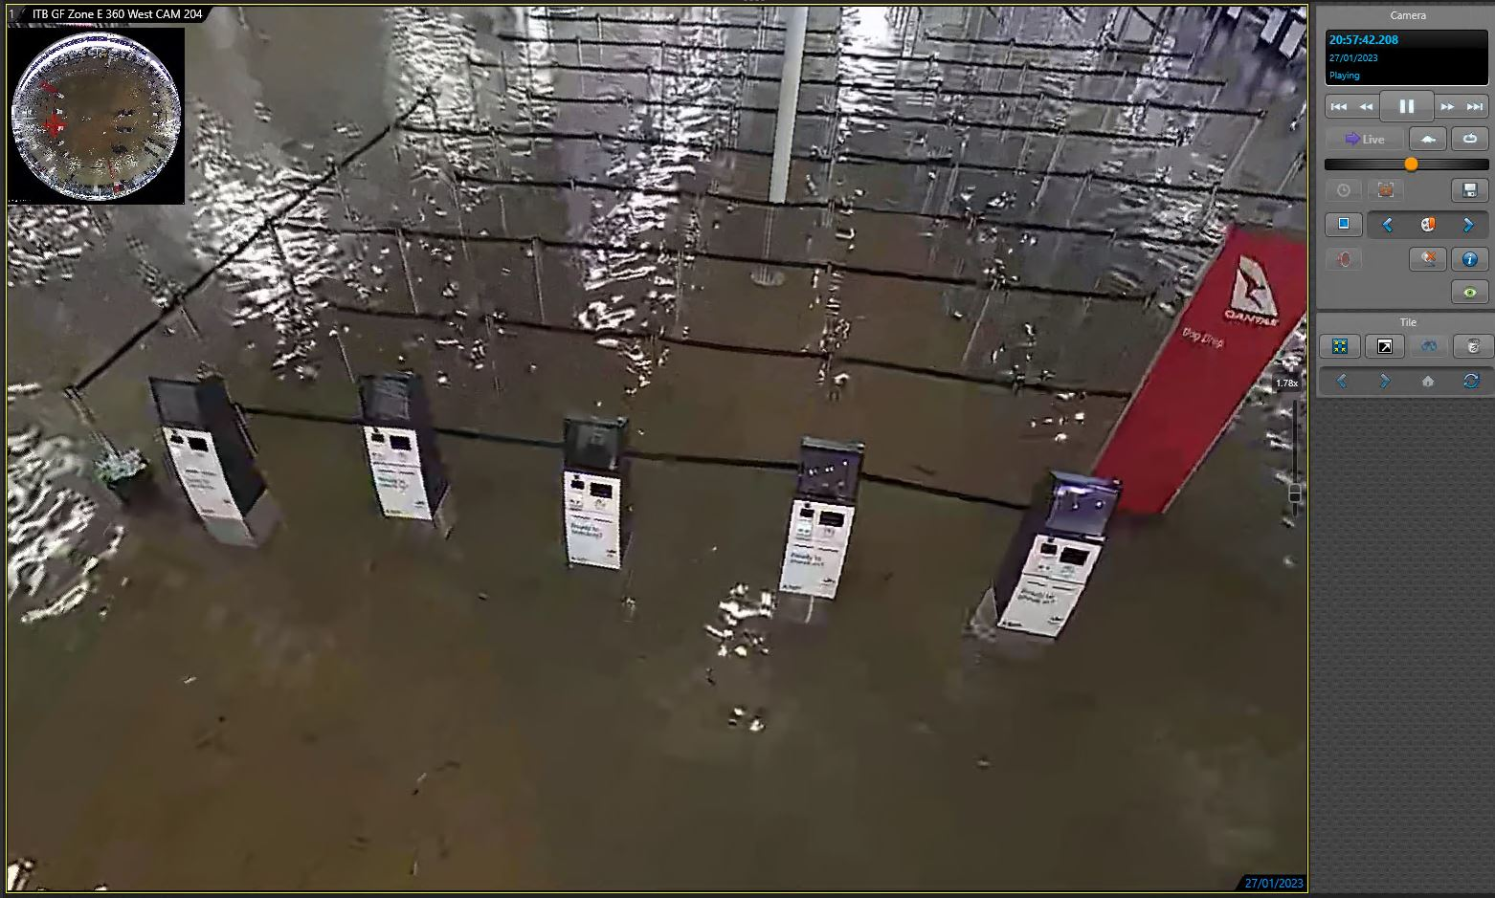

Slide 14
Timeline of events
Friday 27 January
2030
Auckland Airport Crisis Management Team stood up
Friday
27 January
2100
Ground Flooding Closed the International Terminal Building (ITB)
Friday 27 January
2108
Runway Closed to Arrivals Due to Terminal Flooding
Saturday 28 January
1025
DTB reopened for services
Sunday 29 January
0500
ITB Departures recommence
Sunday 29 January
0700
ITB Arrivals recommence
Notes:
This shows how quickly the event took place and how quickly we were able to get the business back up an running.
We stood up our CMT very quickly.

Slide 15
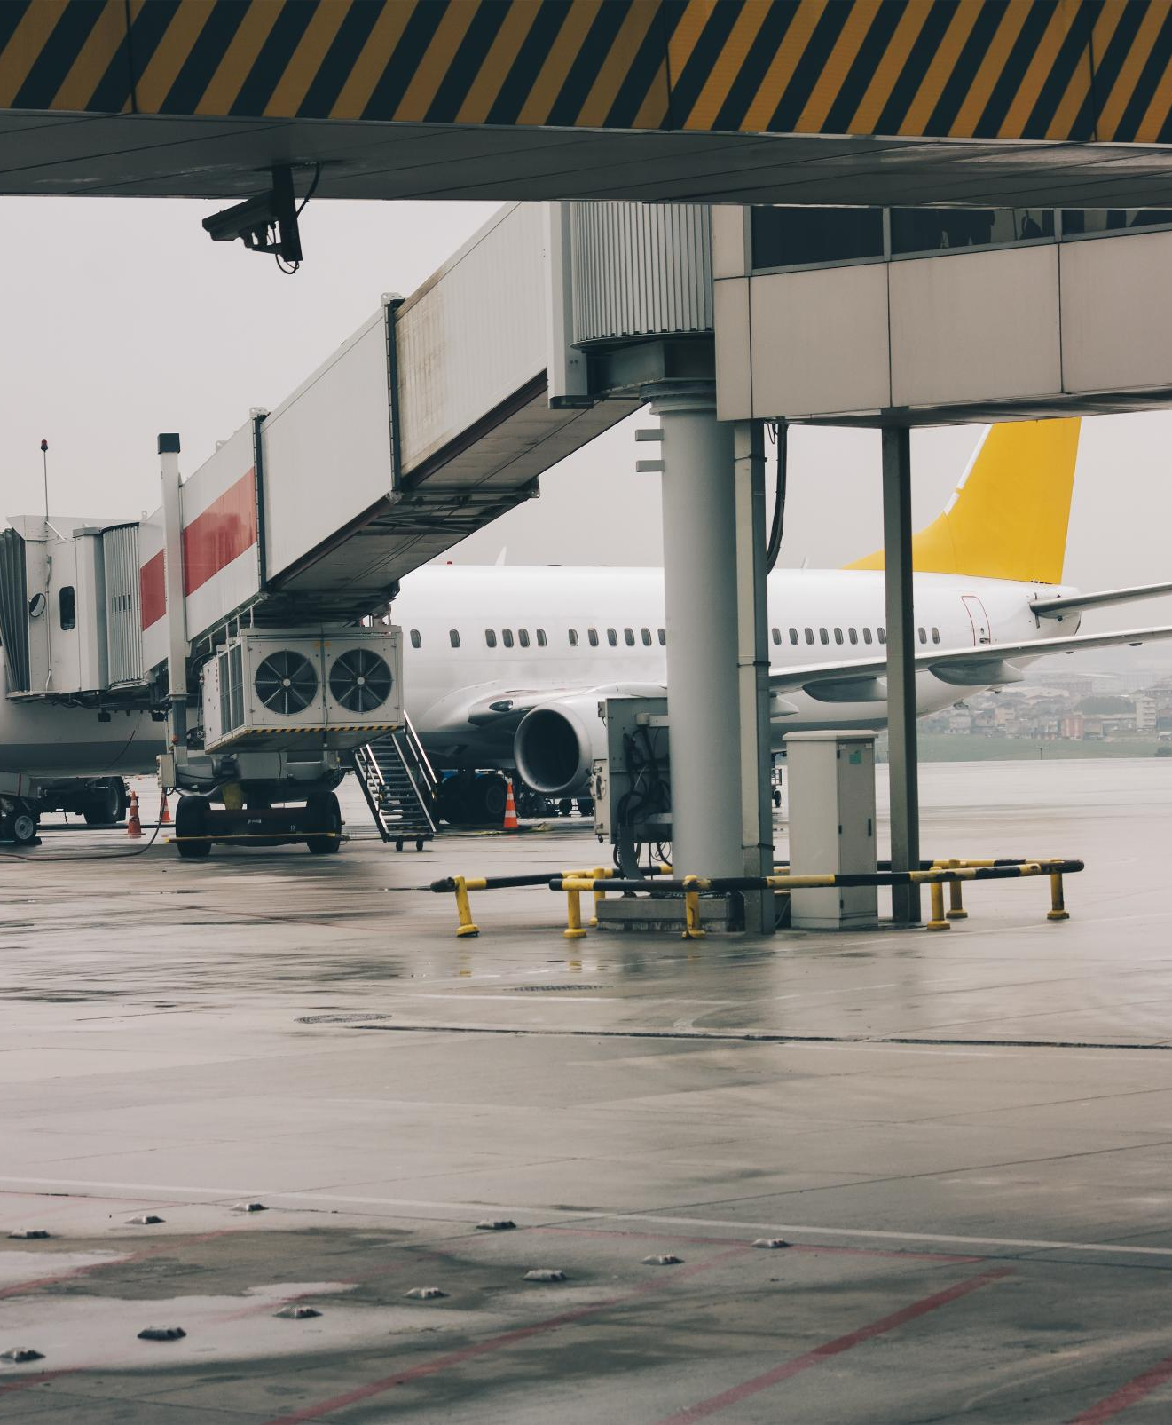
Temporary Closure of the Airport
Reason for Closure – Runway vs airport precinct vs Airways controlled aerodrome area
While it was generally discussed as an airport closure, the legal nuance to a closure is more technical than that. AIAL is responsible for the safety of the runway, and the runway was closed for a period. AIAL then also closed the airport.
Safety Precautions
Closing the airport was a critical decision made to ensure the safety of everyone on the precinct.
Impact on Operations
The temporary closure significantly impacted flight operations and travel plans of thousands of people.

Slide 16
Immediate Actions Taken in Response to the Crisis Friday – Sunday
Notes:
In the wake of the flooding, swift action was essential. This section outlines the immediate steps taken in response to the crisis, including emergency protocols and initial assessments.

Slide 17

Emergency Response
Activation of Emergency Protocols
Emergency response teams quickly activated protocols to protect airport staff and passengers during hazardous situations.
Safety of Staff and Passengers
Ensuring the safety of airport staff and passengers was the top priority during the emergency response efforts.
Notes:
Emergency response teams activated protocols to ensure the safety of airport staff and passengers. Evacuation procedures were initiated where necessary to respond to hazardous conditions.

Slide 18
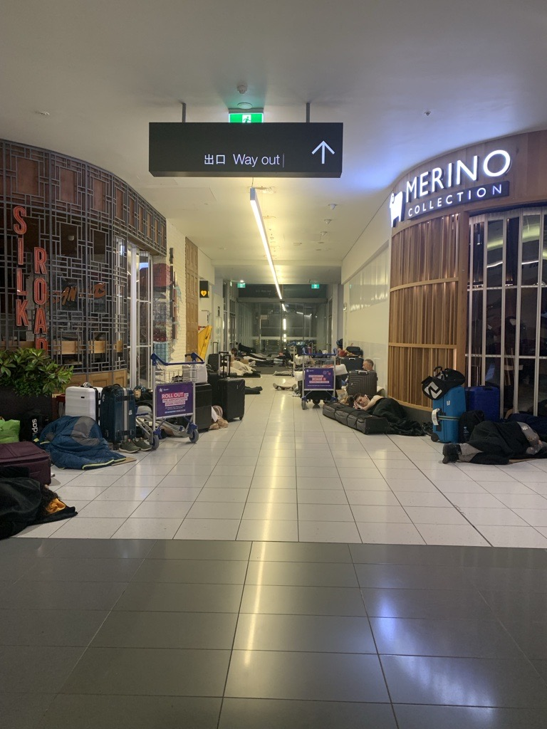
Immediate issues to deal with:
Prevent harm to people:
Safety of people currently on the precinct
Stopping more people coming to the precinct
Minimise harm to property:
Safety of aircraft on route to the airport
Safety of equipment at the airport
Minimize financial impact to the business
Notes:
We had planes in the air on the way to Auckland. We had to determine at what point we made the call to ask them to divert.
We had planes on the ground waiting to depart, we had to make the call to ask them not to take off and come here.
We had people sitting on planes airside.
We had people in the arrivals hall.
We had people in the departures area ready to Board.
This was across the ITB and the DTB.
Immediate comms to the public not to come to the airport were sent.

Slide 19
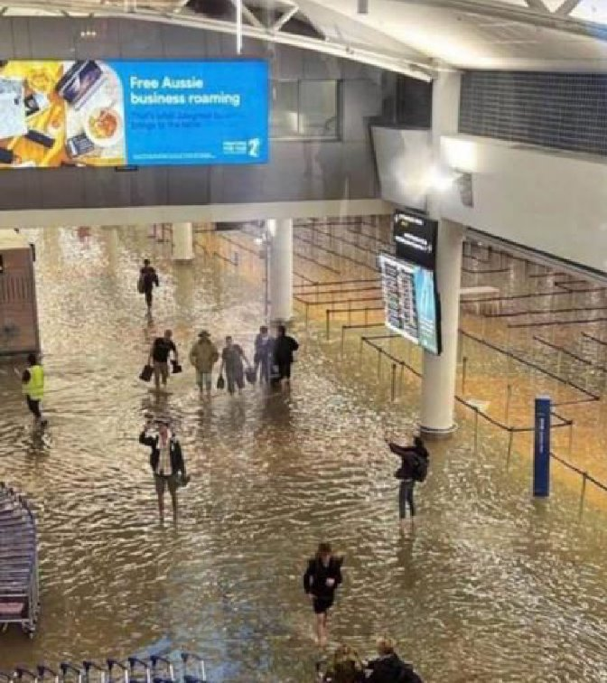
Immediate issues to deal with:
External parties to contact:
Police
Government agencies – Crisis Management agencies
Insurance brokers
External legal counsel
Media
NZX / ASX
Key stakeholders – airlines and Government agencies at the airport

Slide 20

Communication
External Crisis Communication Importance
Effective communication during a crisis is crucial for maintaining trust and transparency with passengers and stakeholders.
Regular Updates via several methods
Airport management provided regular updates to keep passengers and stakeholders informed about the situation and recovery efforts.
Legal approval of messaging
Ensure no liability is admitted until root cause known. Approve key messages and ask team not to deviate. Correct misleading or false statements in the media.
Internal communication
How to communicate with your CMT and your legal team after hours – have personal phone numbers.
Notes:
Effective communication during the crisis was vital. The airport management ensured that passengers and stakeholders were regularly updated about the situation and recovery efforts.

Slide 21
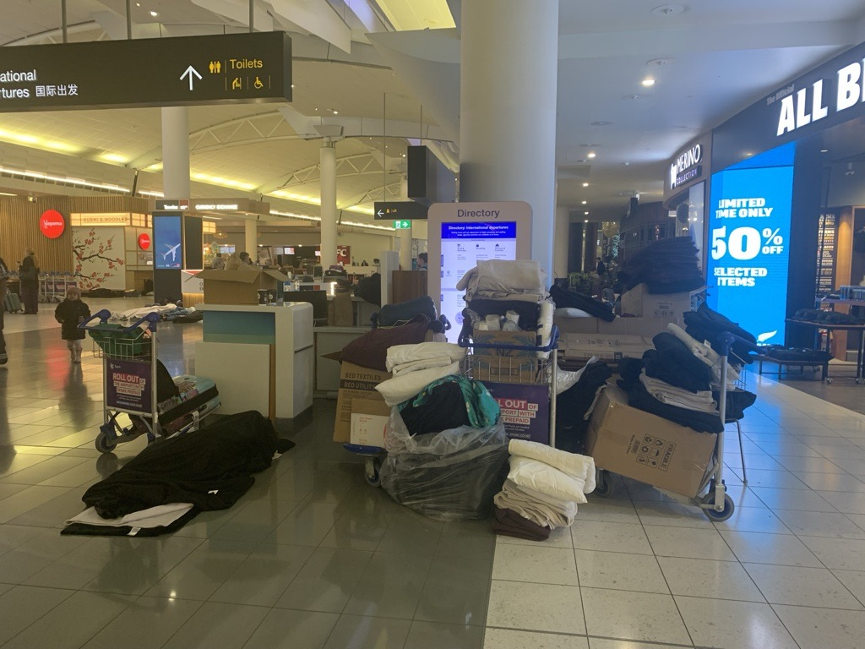
Coordination with Emergency Services
Role of Emergency Services
Emergency services were crucial in the recovery process, assisting in various operations. AIAL has its own firefighting unit, placing us in a very lucky position.
Our first responders we active in support of people and protection of assets.
Notes:
Collaboration with local emergency services played a crucial role in the recovery process. This included support in rescue operations and assessing ongoing risks to the airport's infrastructure.

Slide 22
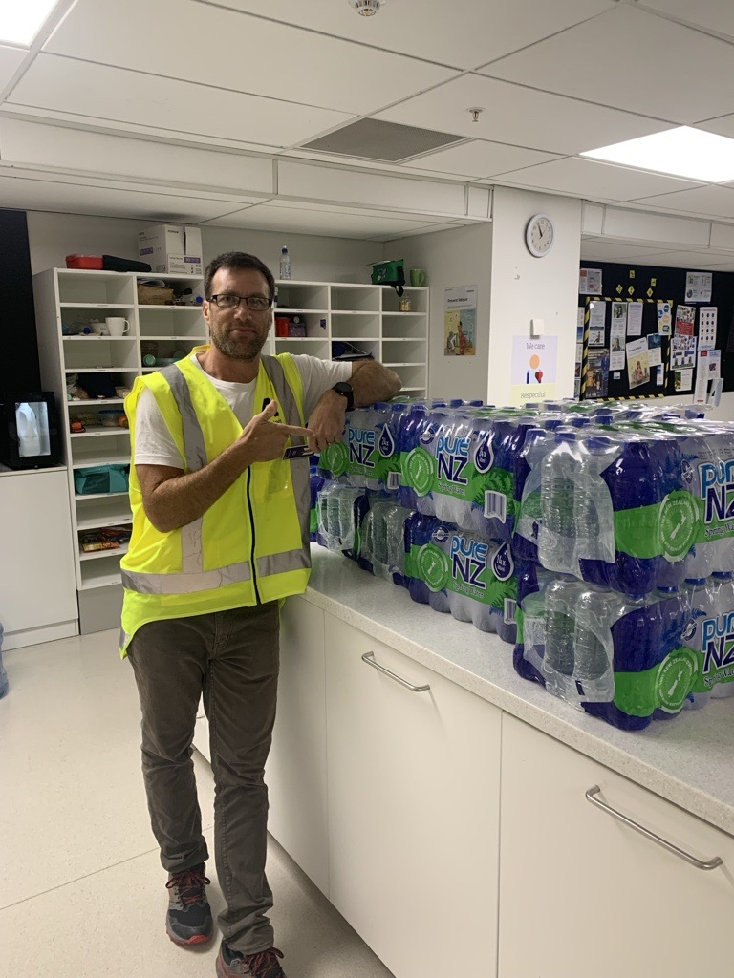
Immediate issues to deal with: 2000 people stranded at the airport
Be prepared for:
Wellbeing of CMT staff – confrontational members of the public and fatigue
Have stockpiles of food / water / essentials (nappies) and regularly check them, have a map of where they are, and keys to access all doors manually to get to them if power is out.
Approximately 4,000 bottles of water provided to stranded passengers and staff.
Support for those with needs.
Manual labour force
Sucker trucks
Sand bags
Contractors
Food and beverage
Blankets
Hotel (Elton John concert)
Marae accommodation
Buses
Language translators

Slide 23
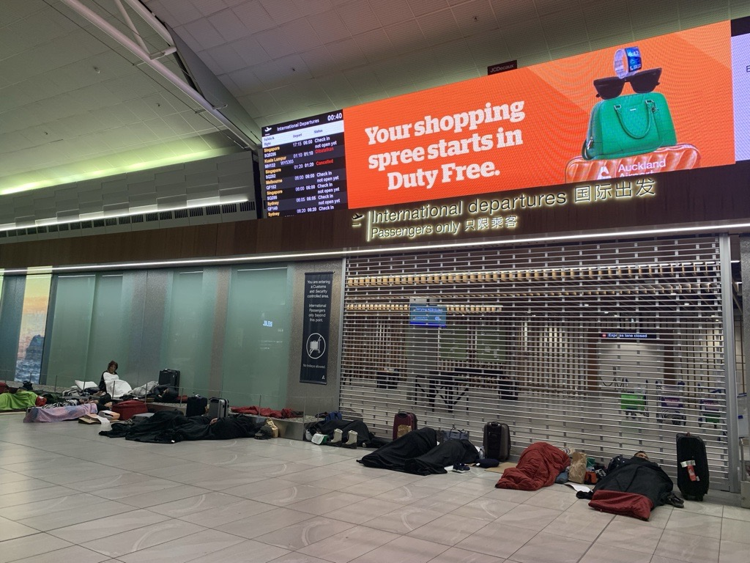
Key Learnings from immediate time period
All hands on deck – not just employees
Strong CMT
Admin staff key for organisation
Teams sites for storage of information
Tracking of costs
Tracking of staff time
Tracking of purpose of expenditure
Data capture: Immediately begin recording steps taken to minimise further damage and purpose of actions
Communication: Immediately begin communicating with insurers on steps taken. You do not need pre-approval in this phase, however start a good practice of communication.
Make decisions on damage mitigation steps / tools quickly – (sucker trucks). If it is an incident that impacts more than your company, demand will be high for the same types of goods / equipment / services
PCBU obligations and joint PCBU obligations start to come into the mix

Slide 24
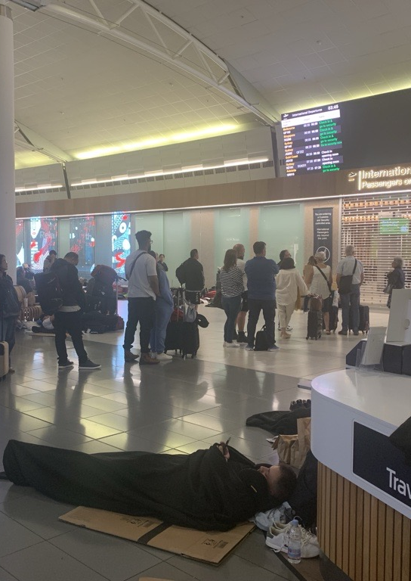
Outcome of immediate response:
BAU operations back up and running using manual work arounds. Limited financial impact to core revenue stream.
2000 people moved on from the airport
Minimal passengers on our precinct waiting for a flight
Small number of people needed medical attention and this was well catered for

Slide 25
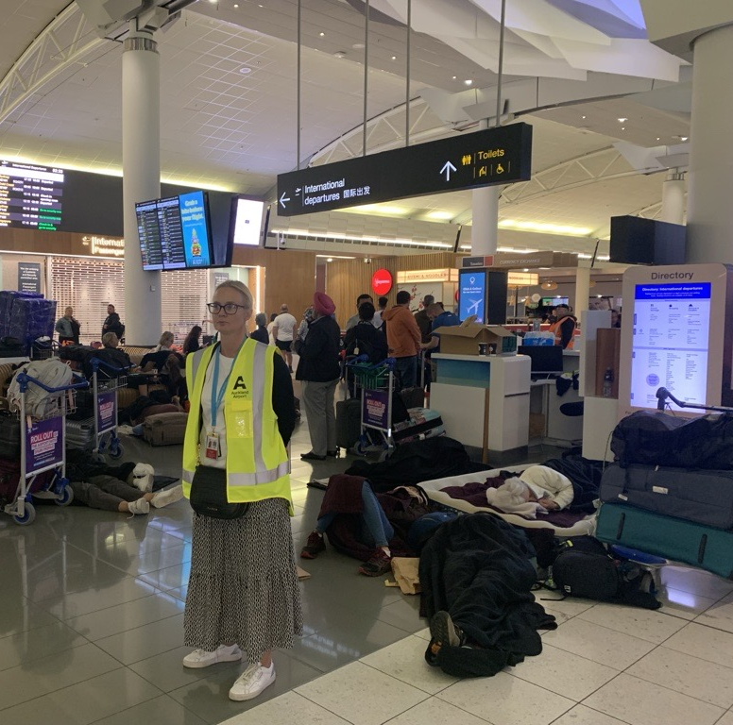
Short-Term Recovery Efforts – Sunday onwards after full re-opening
Notes:
Short-term recovery efforts focused on restoring critical infrastructure and ensuring effective communication with passengers and stakeholders. This phase was essential for resuming operations.

Slide 26

Minimizing Revenue Impacts and Business Downtime
Crisis Management Objectives
One objective of the CMT is to minimize the impact of a crisis on revenue and operations. Start to focus on the steps you can take to bring your revenue back.
Strategic Planning
Strategic planning is essential to ensure a swift return to normal operation and limit downtime.
Notes:
A primary goal of the crisis management team is to minimize revenue impacts and business downtime. This involves strategic planning to resume operations as quickly as possible.

Slide 27
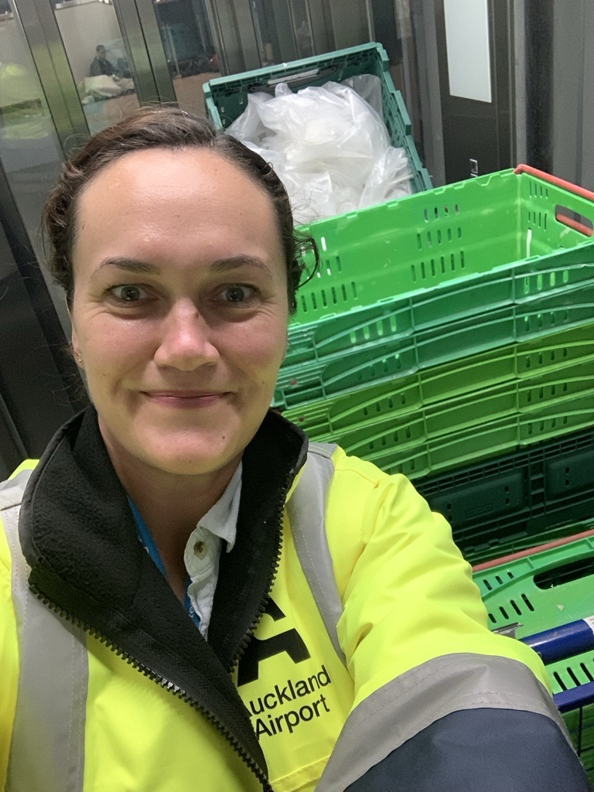
Restoration of Critical Infrastructure
Damage Assessments
Obtaining initial opinions on extent of damage.
Determine Priority of Restoration
Restoring essential services was a key focus during the recovery phase to improve functionality.
Resourcing
Resourcing planning for how to achieve this with fatigued staff.
Operational Adjustments
The reopening of Auckland Airport required operational adjustments to ensure safety and legal operational requirements were met.
Notes:
Restoring essential services and infrastructure was a priority during the recovery phase. This included repairing damaged facilities to ensure safe and efficient airport operations.

Slide 28
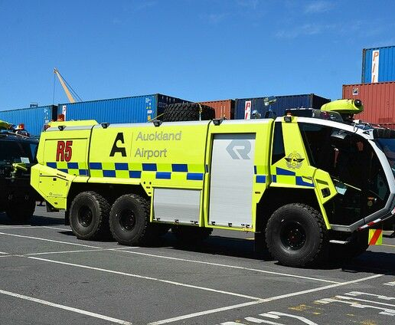
Obtain an understanding of the damage and the impact that has on your business. Being able to explain the importance of an asset being damaged, enables you to navigate finding a head of loss under your policy to claim under and also to explain why you have incurred certain costs.
34 zones initially identified as affected areas. This increased to 72 zones as we progressed through the remediation works due to evidence of corrosion surfacing later on
16 Lifts and 11 Escalators impacted – making passenger movement a real challenge
5 bathrooms were impacted
120 Check-in Self Service Kiosks impacted – an asset that is crucial for any airport's daily operation
Approximately 5,000 sqm of GIB replaced
Several vehicles and one Panther Firefighting truck damaged

Slide 29
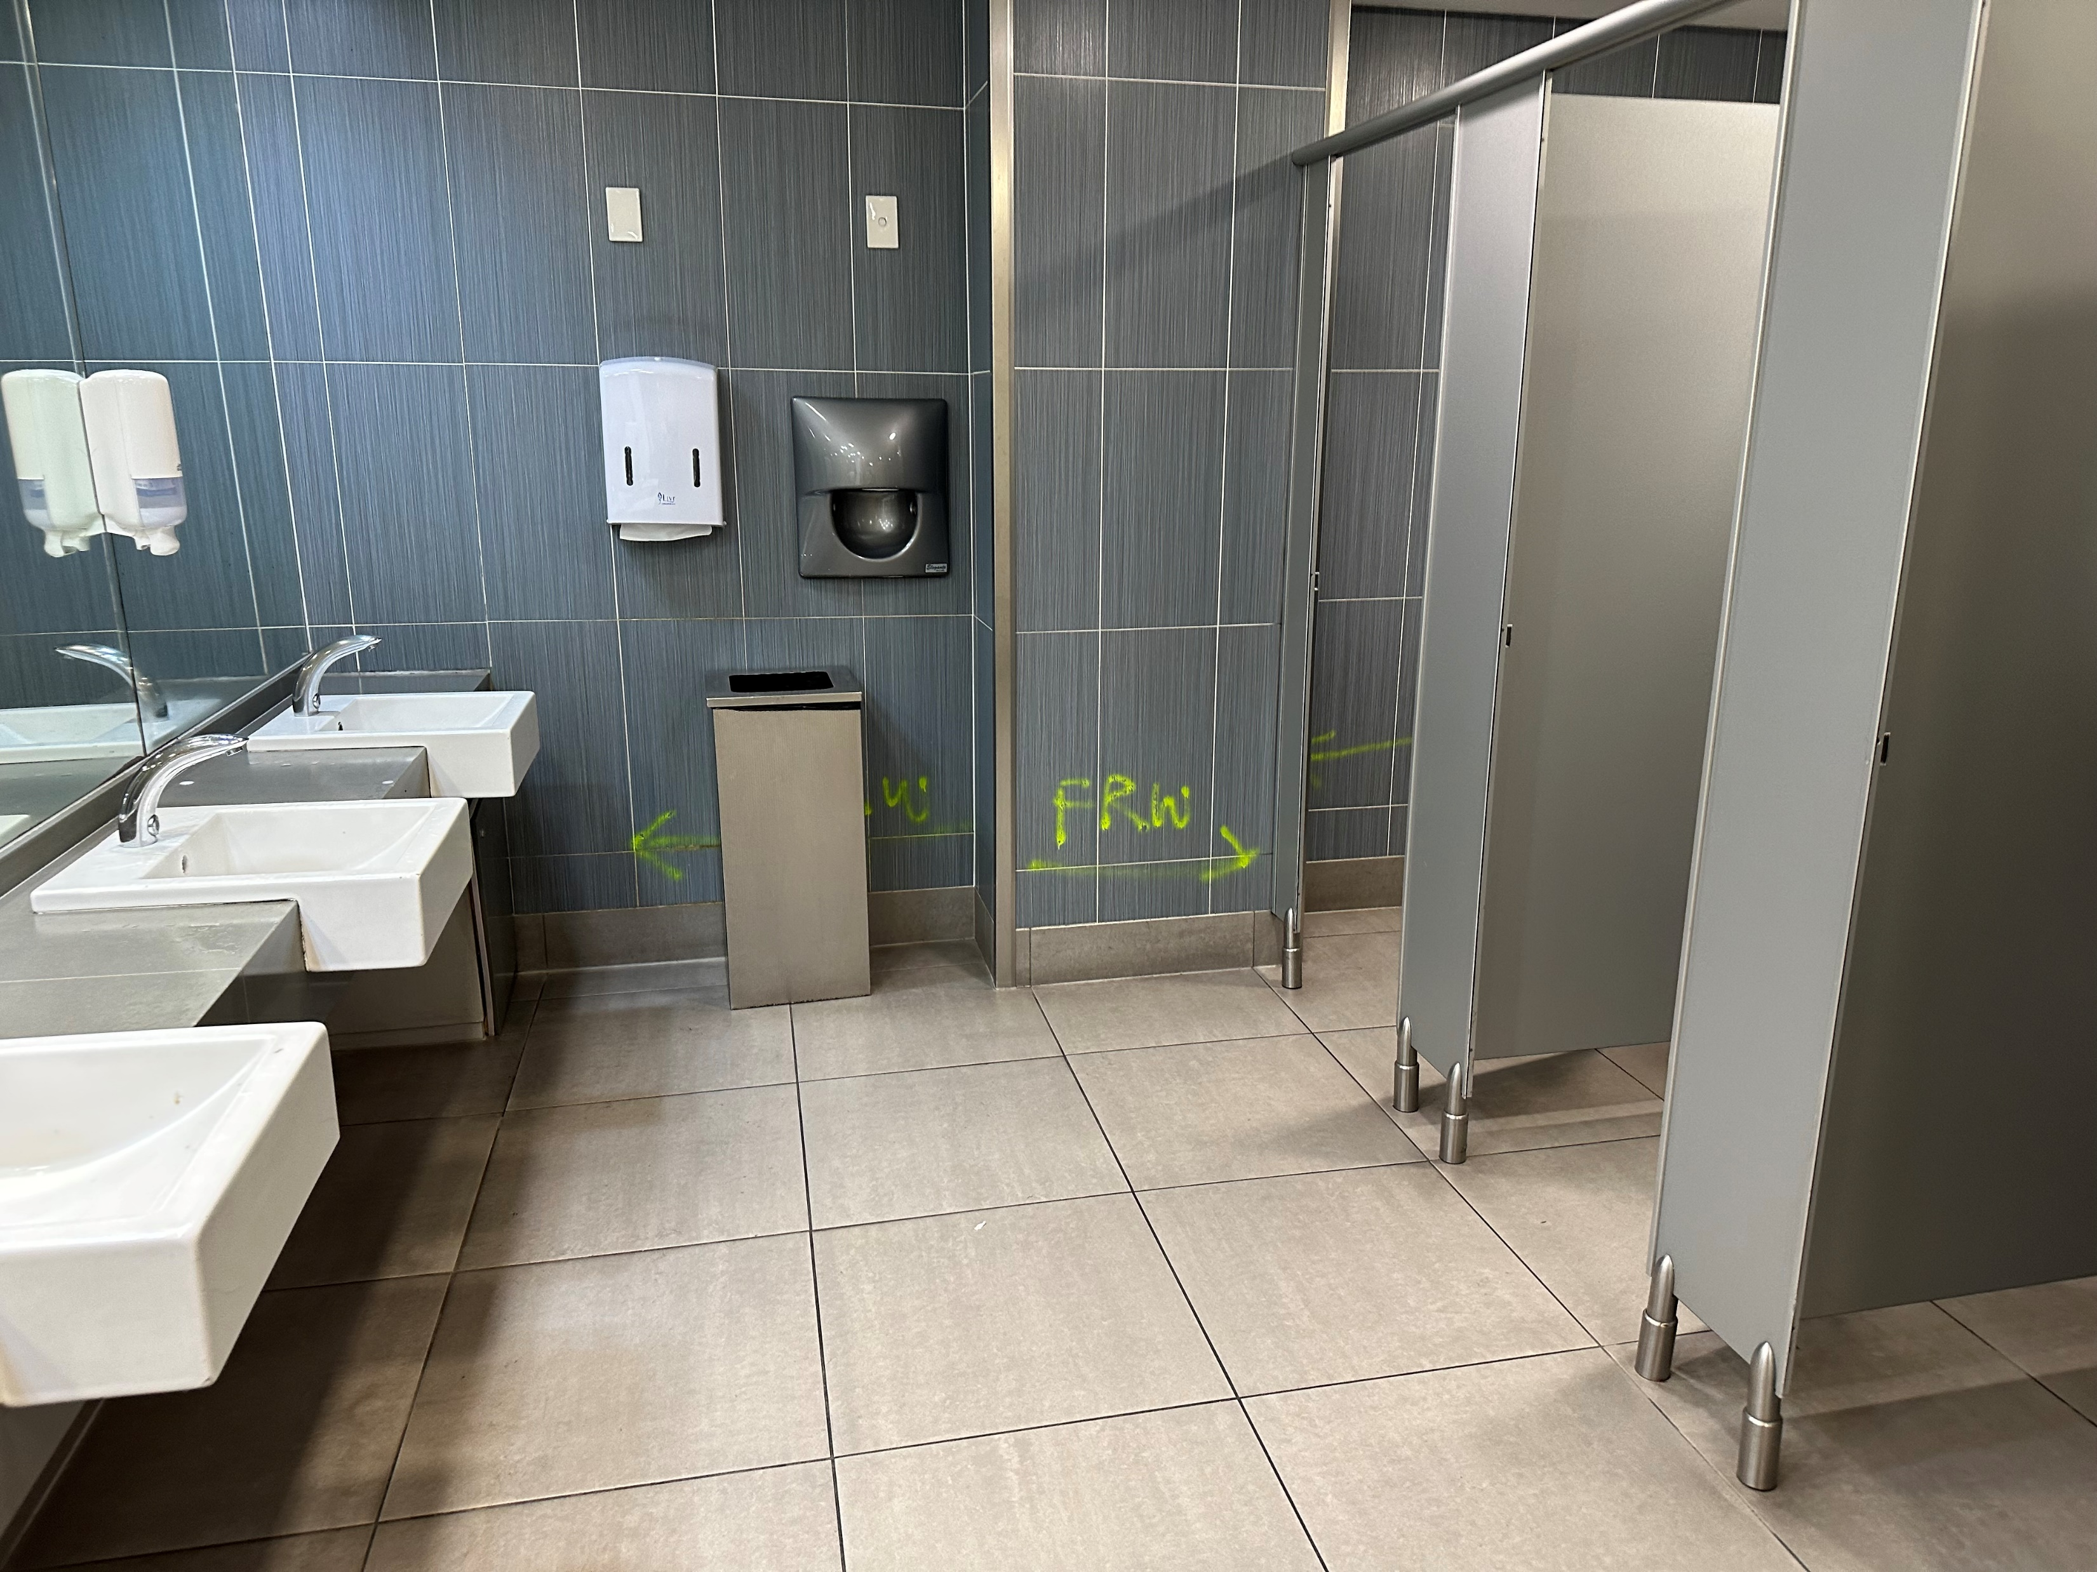

Slide 30
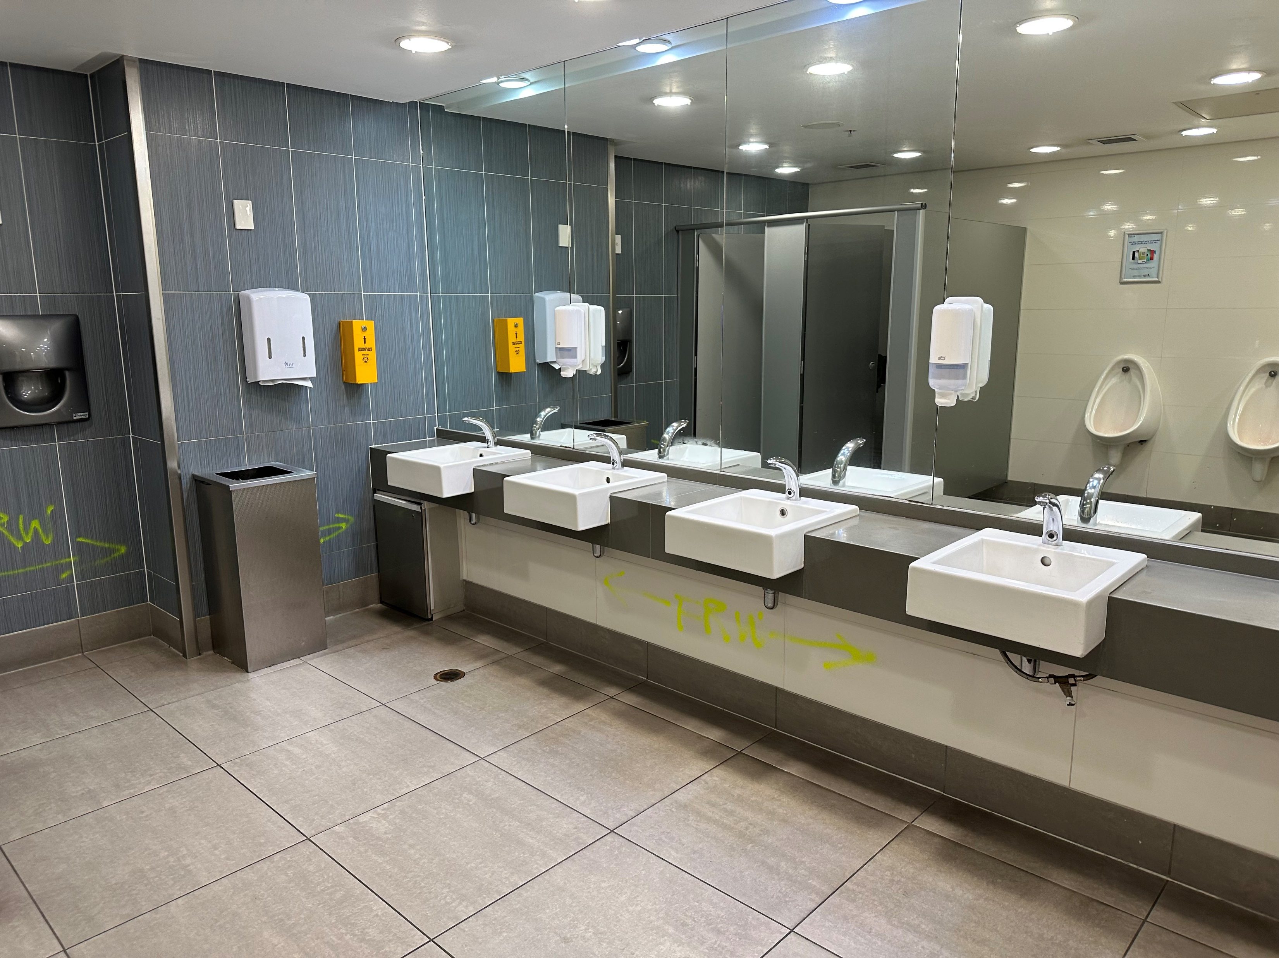

Slide 31
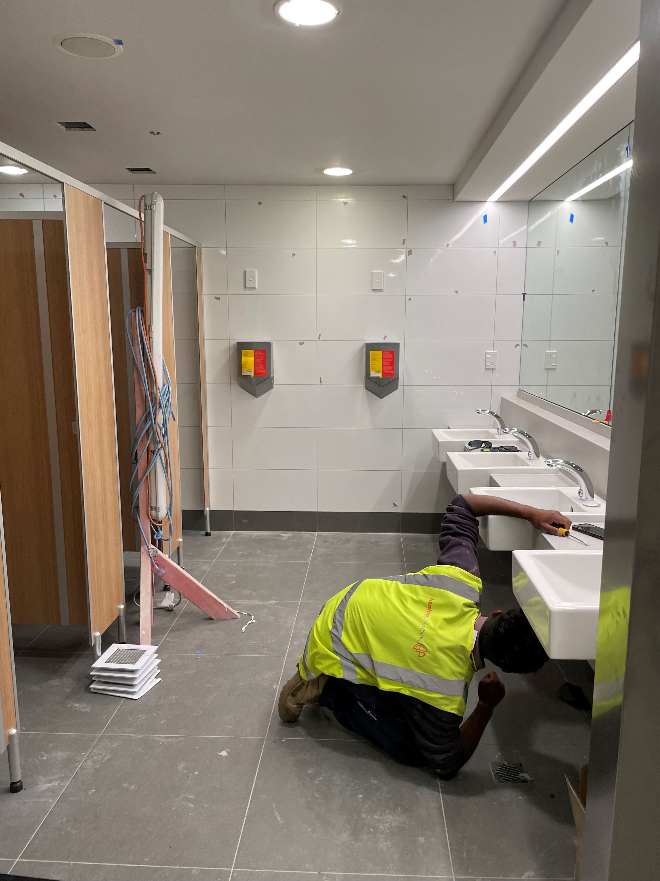

Slide 32
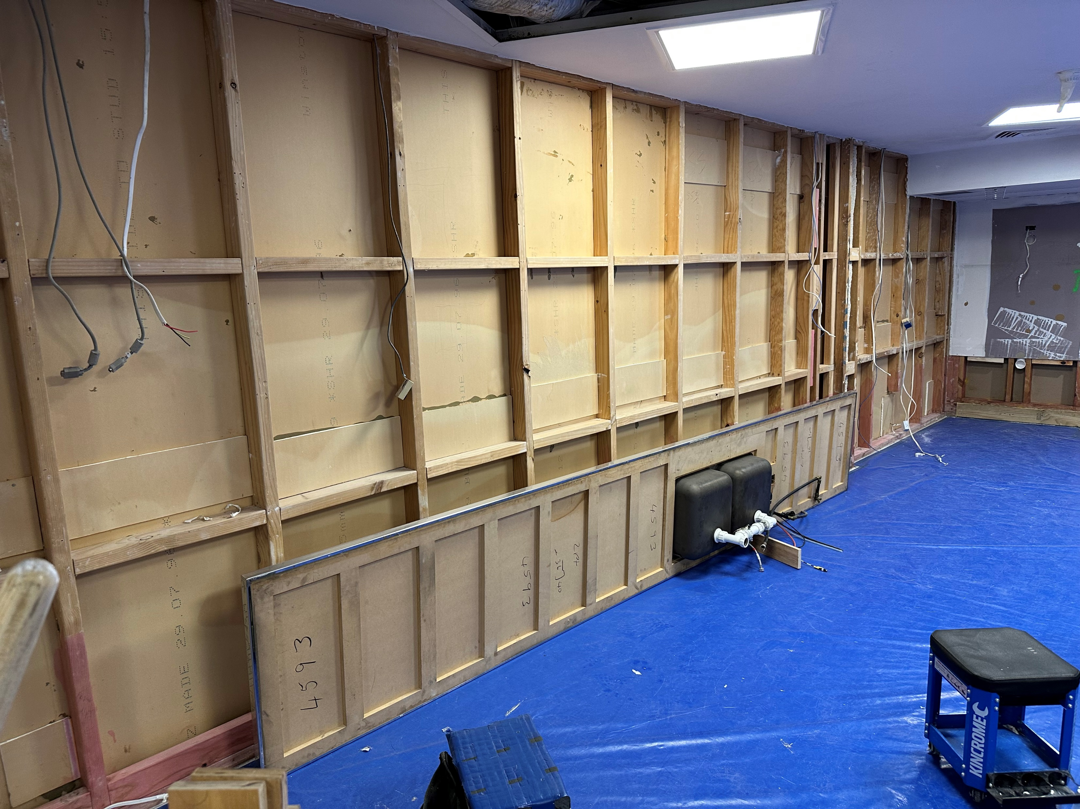

Slide 33
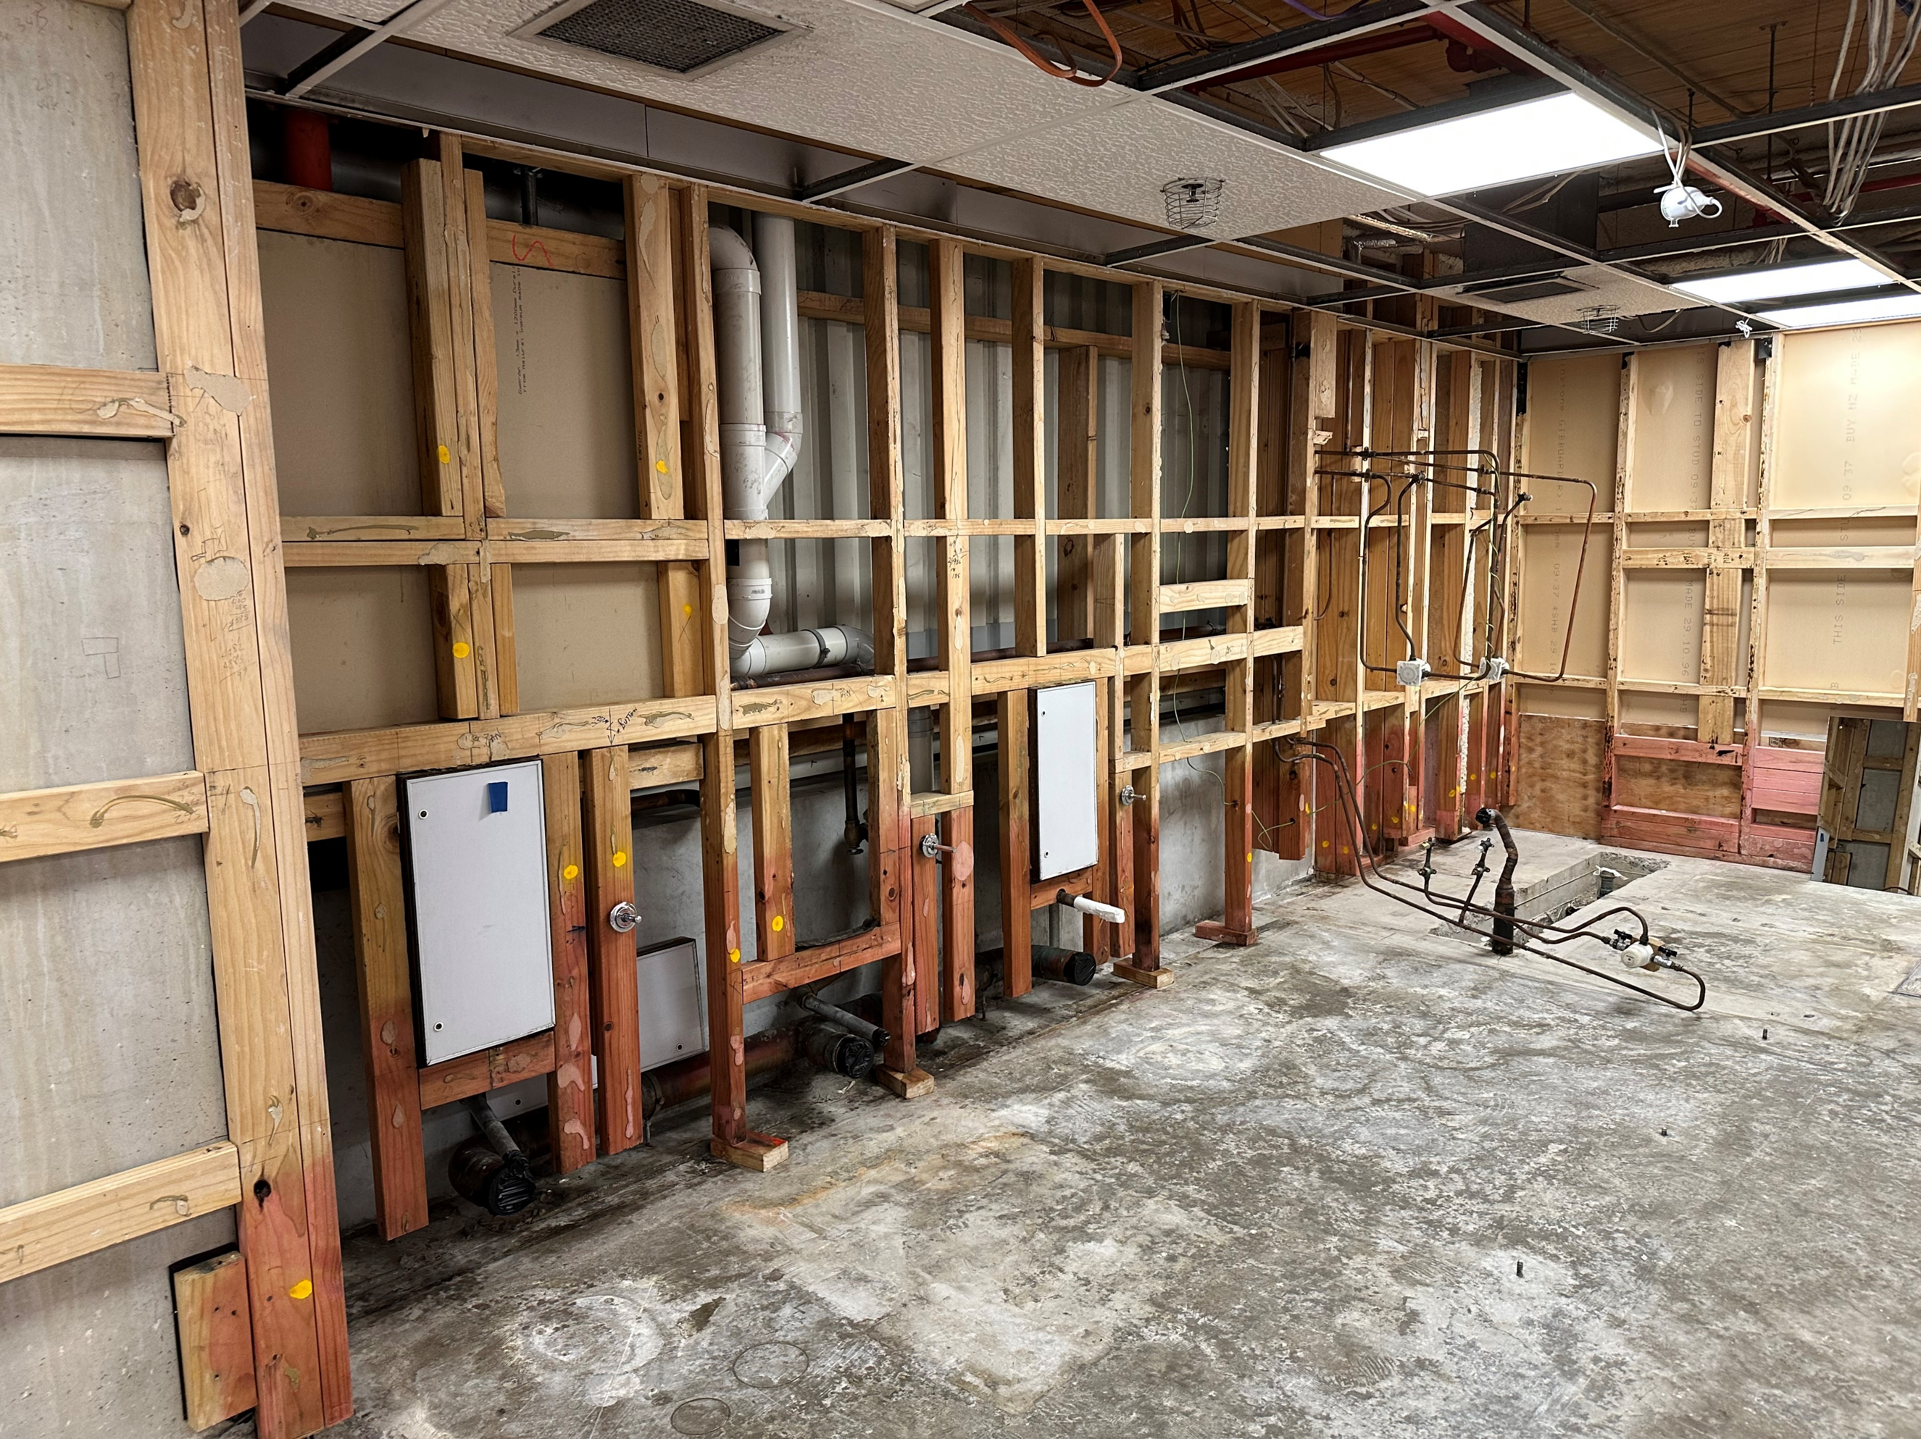

Slide 34
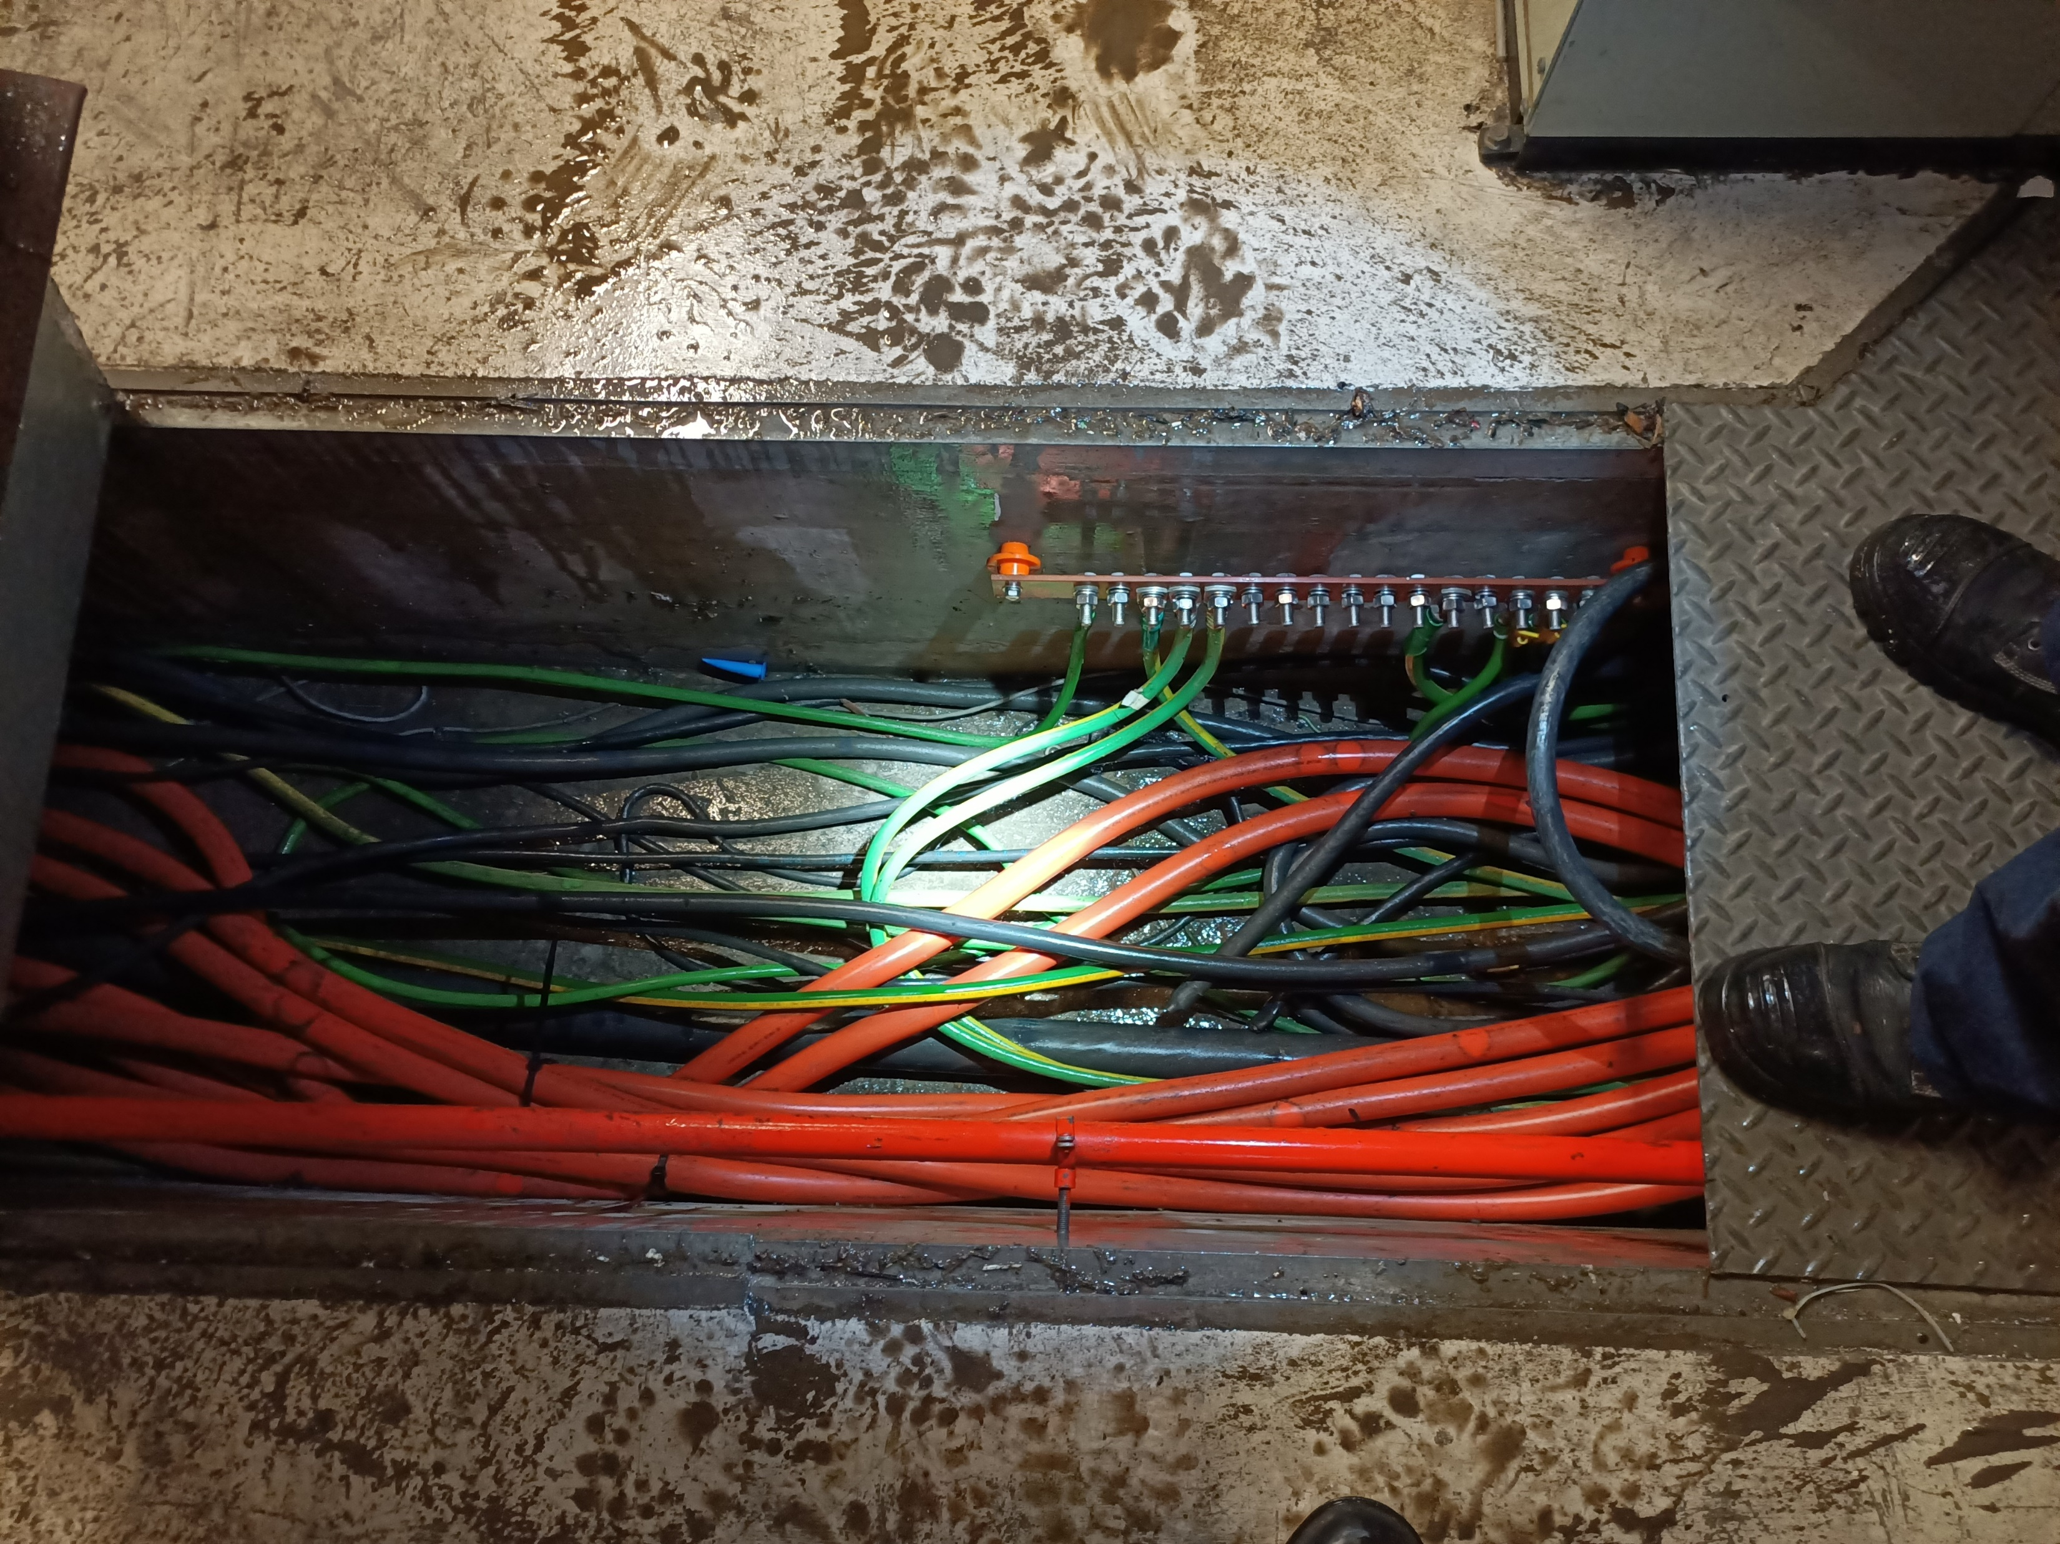

Slide 35
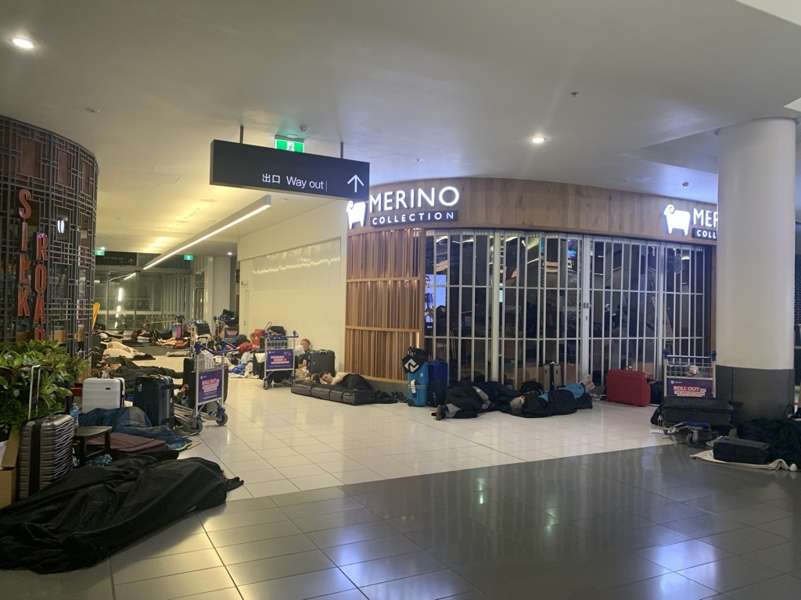
Consultants engaged
Your team:
Insurance brokers
Loss adjustors
Media advisors
External legal
Internal Document Controller / Flood Claim admin role created
Specialist experts from NZ (and abroad flown in)
Manual labour force
Building works contractors
H&S advisors
Scientists
Cost consultants
Equipment specialists
80+ Third Party contractors/experts/professionals engaged
Employees: 165 Airport staff were engaged – over 11,000 staff hours tracked over 18 months
30+ tenants impacted
The insurers team:
Insurers Loss adjustors
Insurers
Reinsurers
Expert consultants – one to match each of yours

Slide 36
Key learnings from short-term time period:
Take caution in engagement of consultants
Who in the business can instruct a consultant
Terms of engagement are needed
Rates / prices to be discussed and recorded
If root cause is unknown – legal team to have a session with the business to explain the need to be cautious around cause of damage. Repeat this session several times. If in doubt, admit no liability.
Obtain all reports from consultants in draft. Never final. Legal to approve final versions.
Be clear on scope of engagement – is the work to identify damage, repair damage, determine cause?
Consider approval by loss adjustors of the consultants you approve. This may benefit you later on when multiple expert reports will be considered and may be at odds with each other.
Internal process for sharing of information. Consider if you need a confidentiality agreement.
Data capture: Set up systems for data capture that will endure staff changes. Obtain data from staff working during the incident. Fullsome interviews / observations / photos and videos.
Prepare agreed messages for both internal use and external and update them constantly. Expect increased levels of communication within your business and therefore increased levels of risk of inaccurate information being shared.
Notes:
Cost: Especially where the H&S of people is involved, no one discusses the cost of goods/services in an immediate time period. This is the best way to approach it, however can lead to unintended consequences. Don’t forget your normal procurement processes. Go back and comply with them if you don’t at the time.
Pre-approval for cost: Carefully determine whether you want to obtain prior approval to incurring cost or whether you want to go ahead and claim after the fact.

Slide 37
Key learnings from short-term time period:
Begin to understand your insurance policies. Use external legal support.
What are your excesses – are the individually under each policy or do you have a combined excess across several policies.
What costs are likely to be covered
What are unusual exclusions
What are the core sentiments of your policies – entitled to be put into the same position you were in immediately before the incident.
This will start to guide your communications with insurers, how you engage consultants, how you make decisions on what costs to incur.
Start to understand repair / replace / betterment.
Review records of state of assets before the incident.
Financial losses: Set up systems for coding / allocating losses to the claim.

Slide 38
Key learnings from short-term time period:
Understand the roles of the insurer’s team and their objectives:
Think ahead to settlement negotiation, and understand that they are paid by the insurers to interrogate loss, policy liability and dispute evidence.
Lean on people who have been through the same event before – ask your brokers to connect you with their other clients who have been through it before. Reach out to the legal community – you can always reach out to Louise as well

Slide 39

Key learnings from short-term time period:
Resourcing: Restructure your organisation with new clearly defined roles, which may even require a management of change process.
A large incident that takes time to repair / reinstate will take significant internal resource. Decide if people will remain in their roles, move to work on the incident or whether you will bring in external resource to increase capacity.
Read your policy to determine coverage for these costs as they may shape your decisions.

Slide 40
Cyclone Gabrielle
A second event occurred in Feb 2023.
Legal considerations:
Delineation between two different insurance claims
Categorisation of work – was it done to mitigate the potential loss from a second event, or was it work related to the first claim, or was it work done to repair damage from the second event?
Data capture: Start recording as soon as an incident occurs, even if you think it is not material and falls beneath your excess. Costs may total to a number that the business considers it is worthwhile making a claim.

Slide 41
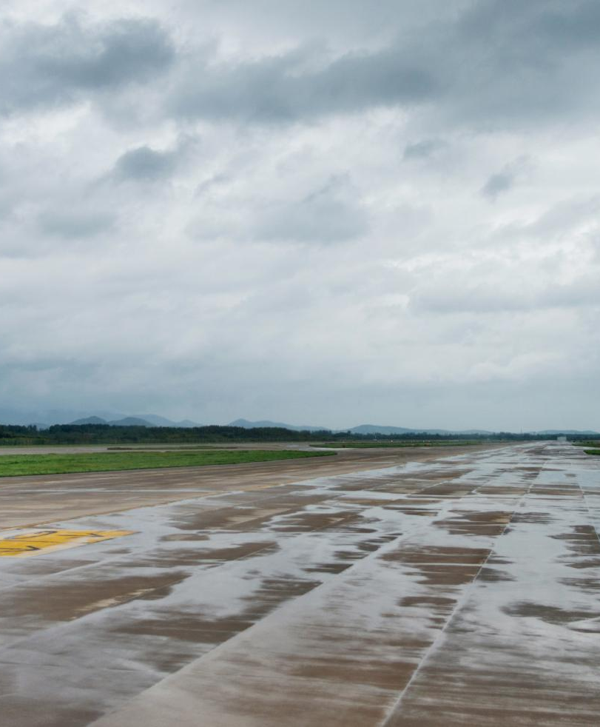
Long-Term Infrastructure Improvements
Response to Flooding
Strategic planning for long-term infrastructure improvements has begun to mitigate future risks.
Enhancing Resilience
The primary goal of these improvements is to enhance resilience against extreme weather events, ensuring operational continuity.
Improving Operations
These upgrades will also improve overall airport operations, leading to better efficiency and passenger experience.
Insurance considerations
Understand the difference between future resilience that is not related to the claim and work done to get the business back into the state it was before the incident.
Notes:
In response to the flooding, long-term infrastructure improvements were planned. These upgrades aim to enhance resilience against future weather events and improve overall airport operations.

Slide 42
Legal Role in Insurance Claims
Notes:
Navigating the legal aspects of insurance claims is crucial for recovery. This section discusses the $28 million insurance claim, along with the necessary legal considerations.

Slide 43

Legal Considerations
Importance of Documentation
Proper documentation is essential for successfully managing insurance claims and ensuring claims are processed efficiently. Set your claim up for success with good data systems.
Gathering Evidence
Gathering evidence of damage is crucial for substantiating insurance claims and fulfilling policy requirements.
Compliance with Policies
Ensuring compliance with insurance policy requirements helps in avoiding claim denials and ensures coverage. It is crucial for lawyers to thoroughly understand the intricacies of insurance policies to effectively navigate claims. Understanding timeframes for making a claim under the policy documents.
Effective Communication
Successful claim management relies on clear and effective communication between lawyers and insurance companies.
Financial results
The impact and accounting treatment of the insurance monies received and monies spend (Opex vs Capex) will need to be considered.
Notes:
Proper documentation and legal considerations are vital in handling insurance claims. This includes gathering evidence of damage and ensuring compliance with insurance policy requirements.

Slide 44

Practical considerations
Legal resource for the length of the claim:
Internal resource
External support
Resourcing the repair / replacement process – internal staff vs external staff

Slide 45
Slido Question: In AIAL’s most recent interim results, how much did they disclose they have been paid by insurers for the claim?
A: $8.75m
B: $12.5m
C: $22.5m

Slide 46
Current status of claim:
On 27 January 2023, Auckland experienced widespread flash flooding caused by record-breaking rainfall. Auckland Airport experienced flooding across the precinct and particularly the international terminal building. Both the domestic and international terminals were closed for short periods starting that evening, with domestic flights resuming at midday on 28 January 2023 and international flights from the morning of 29 January 2023. Auckland Airport suffered flood damage to assets across its precinct.
The most significant areas of damage were to checkin, baggage and vertical transportation at the international terminal building. Auckland Airport has material damage, business interruption and construction works insurance policies in place.
The group engaged independent experts to estimate the extent and cost of damage and to support the insurance claim process.
The group recognises the expected insurance proceeds when they can be reliably estimated and the recovery is virtually certain. The insurers agreed to a further payment of $4.0 million, which the group has recognised as income during the six months ended 31 December 2024. In total, the group has recognised $28.0 million as income since the January 2023 event. The repair and replacement of damaged assets is advanced, save for vertical transport, which is planned to be completed during the 2025 calendar year. During the six months ended 31 December 2024 the group recognised $1.5 million of flood related expenses for repairs.
In total, the group has recognised $22.3 million as flood-related expenses since the January 2023 event. The group has recognised net proceeds of $2.5 million in the consolidated interim income statement during the six months ended 31 December 2024 and net proceeds of $5.7 million since the January 2023 event.

Slide 47

Ngā mihi nui Thank you

