Slide 1
GREENFIELDS LEGAL FUNCTIONS
A Crowd Sourced How-To
My experience and Initiatives in the first 6 months
Crowd Sourcing - What has been your experience and what are your awesome ideas?
Pulling it together with the wisdom of the network

Slide 2
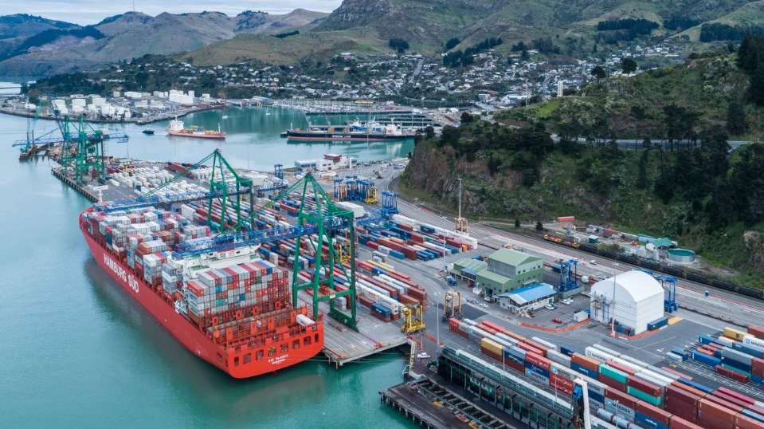

LYTTELTON PORT COMPANY - CHRISTCHURCH
AUGUST 2024
CHIEF LEGAL RISK OFFICER
Largest Port in the South Island – 3x sites
Heart of a growing hub and spoke model servicing cargo arriving via both coastal transshipment and rail for international export
CCHL / CCC Shareholder ownership
650 staff –operationally 100% unionised
Ambitions growth plans - construction and plant
Challenging industrial relations
Shifting the dial on health and safety include prev prosecution
High value litigation on foot – strategic + $
NO INTERNAL LEGAL TEAM – EVER
No one-size fits all…

Slide 3
So…where does one begin?? (after some phone a friend!)
Scope – Assessing Current State (Risk + Spend)
spend reporting, high level business unit reviews (external report), trends and red flags
Narrowing Focus
establishing pillars based on most immediate need. Eating the elephant, replacing some rocks
Communicating for the purpose of buy in
articulate clear focus (any excuse to present) align all tasks with pillars
Minimum viable requirements / Easy Wins
Clear DFA’s, Contract Approval Sheets, Contracting and
Privacy Policies, set up a Panel
Demonstrate value
Be vocal about a team’s success, training, pitch up with a report
Set Up
Scope
Narrowing Focus
Buy-In
Honing in on minimum requirements
Make it all reportable
Managing Volume. Politics / Patch Protecting. Morphing role

Slide 4
The Crowd-Sourced How-To
4 Groups
10 minutes sharing your top tips, strategies and ideas
What did you want to know when you got to this seat?
What would you do over if you had the opportunity?
Final 10 minutes to share at the end – top 2 points
How do you go about scoping the need?
How do you organise your focus areas + communicate that?
What are some of your minimum establishing requirements and easy wins?
How do you demonstrate your value and continue to do so in challenging times?

